Slide 1
Professional Vue.js Development
copyright 2026, Chris Minnick
version 2.1, 2026

Slide 2
Introduction and Vue Quickstart

Slide 3
Introduction
Objectives
Who am I?
Who are you?
Daily Schedule
Course Schedule and Syllabus

Slide 4
About Me
Chris Minnick
Author, trainer, developer
Teaching programming since 2000
Teaching AI since 2023
Author of over 25 books, and numerous courses on programming and AI.

Slide 5
Introductions
What's your name?
What do you do?
JavaScript level (beginner, intermediate, advanced)?
What do you want to know at the end of this course?
What do you like to do for fun?
Favorite food?
Notes:
Please answer these questions!

Slide 6
Daily Schedule (CMT)
08:30 - 10:30
15 minute break
10:45 - 12:00
1 hour lunch break
1:00 - 2:00
15 minute break
2:15 - 3:15
15 minute break
3:30 - 4:30
Notes:
This is just a rough estimate. We may take breaks at different points, depending on where we are with the material. But, in general, we'll take a break in the morning, a break for lunch, and a couple breaks in the afternoon.

Slide 7
The Big Picture
Topics Covered in this Course
  Modern JavaScript, DOM and async/await
  Node.js, npm, Vite and build tooling
  Vue.js templates, directives, forms and styling
  Composition API, reactivity and lifecycle hooks
  Components, props, slots and composables
  Pinia state management, Vue Router and APIs
  Debugging with browser and Vue DevTools
  ESLint, TDD, Vitest and Vue Test Utils
  Transitions and animations
Notes:
These are the big topics we'll be covering. If this is shorter than a 3-5 day class, we'll spend less time on the first part and do the other two more together than we would in a longer course.

Slide 8
What's New in JavaScript (aka ECMAScript)?
ES2015 (aka ES6) introduced many new features, including:
  Arrow functions
  Classes
  Block-scoped binding constructs (let and const)
  Iterators
  Modules
  Promises
Since 2015, a new version is released annually
  ES2020: optional chaining (?.), nullish coalescing (??)
  ES2021: String.replaceAll, logical assignment
  ES2022: top-level await, class fields, Array.at
  ES2024: Object.groupBy, Promise.withResolvers

Slide 9
What is Vue.js?
A progressive, incrementally adoptable, reactive front-end JavaScript framework
Notes:
The main thing that makes Vue different from every other front end JavaScript framework is its philosophy of allowing incremental adoption. You don't need to buy into an entire ecosystem with vue when you first get started. it's very easy to just include the vue library in a page and start using it. As you become more skilled with it, you'll want to integrate it into a modern front-end development build, testing, and module structure, but Vue makes that very painless, as you'll see.

Slide 10
What is Reactivity?
The way an application changes the view in response to actions.
Notes:
We use this term 'reactive' in front-end development now to describe a web page changing in response to events. This is the role of every view library.

Slide 11
History of Vue.js
Created by Evan You after working for Google using AngularJS
  "I figured, what if I could just extract the part that I really liked about Angular and build something really lightweight."
Vue was originally released in February 2014.
Vue 3 shipped in September 2020 and became the default in 2022.
Vue 2 reached end of life on 31 December 2023.

Slide 12
What makes Vue different?
Incrementally adoptable
  You can use it with just a script include
  or, you can use it with modern tooling
Combines many of the best features of React and Angular
  Has more built-in features than React
  Less complex than Angular
Small! (~34kb gzipped for the runtime + reactivity)
  Unused features are tree-shaken out of the bundle
Not created by a giant corporation
Governed by an independent team, funded by its users

Slide 13
Comparison of Framework File Sizes
Angular 2 + Rx | 766K
Angular 2 | 566K
Ember 2.2.0 | 435K
Ember 1.13.8 | 486K
Angular 1.4.5 | 143K
React 0.14.5 + React DOM | 133K
React 0.14.5 + React DOM + Redux | 139K
React 16.2.0 + React DOM | 97.5K
Vue 2.4.2 | 58.8K
Inferno 1.2.2 | 48K
Preact 7.2.0 | 16K

Slide 14
Vue vs React and Angular
Vue and Angular have 2-way data binding
  Detects changes to the data model and updates the view automatically.
  Detects changes to the view and updates the data model automatically.
React has 1-way data binding
  Developers write functions or use a state management system to update the model when events happen.
  When the component re-renders, the view is updated from state.
Vue and Angular have built-in utility attributes (directives)
  v-for, v-on, v-bind, v-model
React is mostly just pure JavaScript
All three now favour a function-based, composable component style
  Vue: the Composition API; React: hooks; Angular: signals

Slide 15
Demo: Vue.js Hello World
<div id="app">
{{ message }}
</div>
import { createApp } from 'vue'
createApp({
data() {
return { message: 'Hello Vue!' }
}
}).mount('#app')
// Vue 2 wrote: new Vue({ el: "#app", data: { ... } })
Notes:
<!DOCTYPE html>
<html>
<head>
<script src="https://cdn.jsdelivr.net/npm/vue/dist/vue.js"></script>
</head>
<body>
<div id="app">
{{ message }}
</div>
<script>
var app = new Vue({
el: '#app',
data: {
message: 'Hello Vue!'
}
})
</script>
</body>
</html>

Slide 16
Virtual DOM
Notes:
Virtual DOM manages updates to the browser DOM.
Renders views in memory and compares its rending with what’s currently in the browser to determine how to change the browser window.
DOM manipulation can be slow, but in doing this comparison of virtual DOMs, a framework can find more efficient ways to update the browser DOM.

Slide 17
What Makes Vue Virtual DOM Different?
Can be rendered at run time or precompiled
Tracks a component’s dependencies automatically
  Knows when a component needs to be re-rendered
  Avoids re-rendering components that haven’t changed.

Slide 18
Vue Versions
1.0 - improved template syntax, v-for, hot reloading, scoped CSS
2.0 - virtual DOM, JSX support, server-side rendering
3.0 - Composition API, Teleport, Fragments, Proxy reactivity
3.2 - <script setup>, v-memo, custom-element build
3.3 - generic components, better TypeScript for defineProps
3.4 - faster parser, stabilised defineModel
3.5 - reactive props destructure, lazy hydration, lower memory

Slide 19
What Vue 3 Changed
Reactivity rebuilt on Proxy
  Added and deleted properties are now tracked; Vue.set is gone
The Composition API, and <script setup> on top of it
Fragments: a component may have more than one root element
Teleport: render part of a component elsewhere in the DOM
Multiple app instances, each isolated — there is no global Vue
First-class TypeScript support
Removed: filters, $on/$off/$once, functional component syntax
Notes:
When working with hooks, logic is expressed in function calls that become reusable.
Hooks achieve what mixins do, but avoid two problems that come with mixins:
they allow us to pass state from one to the other
they make it explicit where logic is coming from
Good article about hooks and vue, with demos: https://css-tricks.com/what-hooks-mean-for-vue

Slide 20
Vue QuickStart
Objectives
  Scaffold a project with create-vue
  Understand what Vite gives you
  Run, build and test a Vue app

Slide 21
Code Editors and IDEs
Visual Studio Code
  With the Vue - Official extension
JetBrains WebStorm / IntelliJ IDEA
Zed
Sublime Text
Neovim / Emacs
Any editor with a Volar language-server client will do.
Notes:
Today, there are plenty of code editors and IDEs available for JavaScript development. Purists still maintain that vi or eMacs are all you need, but with so many different libraries and tools involved in modern front-end development, professional developers should take advantage of the advanced features of a full IDE. One of the best ones available is VS Code, and that's what we'll be using in this course. We don’t endorse any particular code editor, however, and we encourage developers to experiment with as many IDEs as they can.

Slide 22
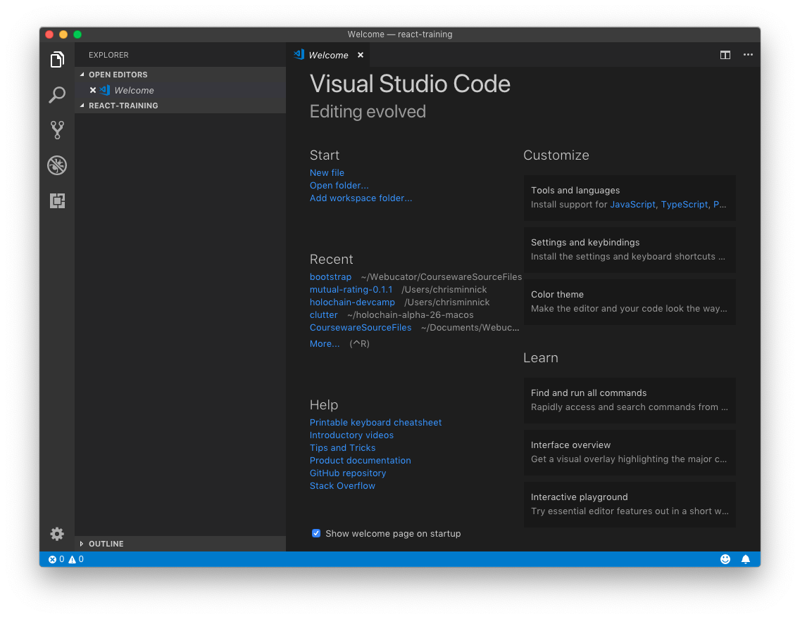
Lab 01: Installing Visual Studio Code

Slide 23
Vite
The build tool behind the current Vue tooling
Development: serves your source as native ES modules
  No bundling step, so startup and reloads stay fast as the app grows
  Hot module replacement that keeps component state
Production: bundles and minifies with Rollup
Framework-agnostic — Vue support comes from @vitejs/plugin-vue
Vue CLI, which used webpack, reached end of life at the end of 2023
Notes:
Vue cli can be used from the command line or from the GUI. I'll demonstrate both methods of using it and then you'll use it to get started with our project for the course. After the demonstration, make sure that everyone can access their virtual machine for the course (if using) or can install vue-cli globally on their machines before proceeding to the next slide.

Slide 24
Using create-vue
Scaffold a project — nothing to install globally
  npm create vue@latest
Then, in the new directory:
  npm install
  npm run dev # start the dev server on :5173
  npm run build # production build into dist/
  npm run preview # serve the production build
The prompts let you add Router, Pinia, Vitest, ESLint up front

Slide 25
Lab 02: Get Started with Vite

Slide 26
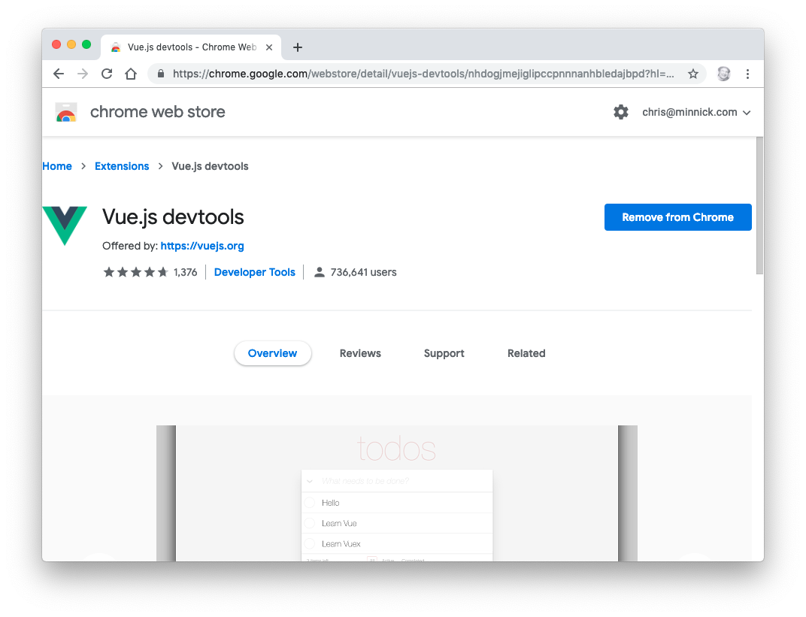
Installing and Using the Vue DevTools
Notes:
Once you have a vue project, you'll want to install the vue devtools for chrome. Here's a quick demo of what you can do with the vue devtools

Slide 27
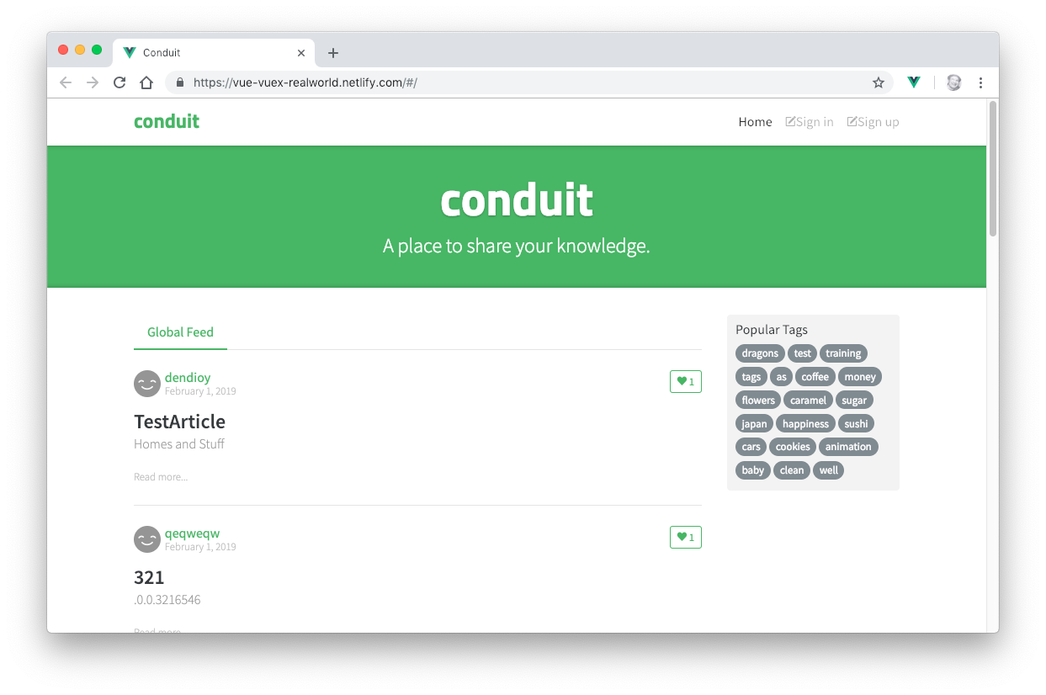
Our Real-world Project: Conduit
Notes:
In this class, we'll be building a real-world application based on Conduit, an open source Medium.com clone. This application will make use of a wide variety of Vue.js features and related technologies, including components, authentication, routing, state management, a RESTful API and more.
Before continuing to the next lab, visit an instance of Conduit at https://conduit.watzthis.com.

Slide 28
Single-File Components
<script setup> - the logic, using the Composition API
<template> - the markup
<style scoped> - CSS that applies to this component only
One file, one component, named after the file.
Compiled at build time, so the format costs nothing at runtime.

Slide 29
Lab 03: Your First Component
Modern JS frameworks use modules to create reusable components.
Components are composed into user interfaces.
Vue's components are called "Single File Components"
  They encapsulate Template, Script, and Style
We write them with <script setup>, the Composition API syntax
  Every top-level binding is available to the template
  The import of a child component is its registration
Notes:
Although it's possible to use Vue by including the script into your html page, as you would do with jQuery, modern javascript frameworks use reusable components. This lab will give you an introduction to what components in Vue look like.

Slide 30
Lab 04: Create More Components
Practice building more components by creating the main sections of the Conduit demo app.
Notes:
In this lab, you'll get more practice with creating Vue components, before we dive into what's happening behind the scenes with the tooling and how components work and how to compose components into a reactive vue application.

Slide 31
Lab 05: Testing Vue
Write your first Vue tests with Vitest and Vue Test Utils.
Notes:
In this lab, you'll configure the tools you need for writing tests.

Slide 32
Node.js
Objectives
Install Node
Test node and get started using npm
Notes:
Behind modern javascript development is node.js, which runs the scripts we use for linting, testing, previewing, and building your applications.

Slide 33
What is Node.js?
JavaScript runtime
Built on Google Chrome's V8 JavaScript engine
Open-source
Event-driven
Non-blocking
  Never waits
Single-threaded
  Can handle thousands of concurrent connections with minimal overhead
No buffering
Used on the server as well as for development automation
Notes:
Node started its life as a way to run JavaScript on the server. However, it's become an essential tool for managing modules, running tools, and automating front-end development.
Node.js allows you to run JavaScript from the command line.

Slide 34
How is Node.js Different?
JavaScript is single-threaded
A Node application has one event loop, and gives you the benefit of multithreading with async operations
  Can handle thousands of concurrent connections with minimal overhead
No buffering
  Node applications never buffer data.
  Data is output in chunks.
Non-blocking
  Node doesn't wait for data to be returned from APIs.
  While it's possible to write blocking code in Node.js, it's discouraged.

Slide 35
Event loop
Problem: JavaScript is single-threaded.
The event loop allows Node.js to perform non-blocking I/O operations.
  Offloads operations to the system kernel when possible
Node initializes the event loop on startup
Loops through 6 phases
Between each run of the loop, Node.js checks if it's still waiting for anything and shuts down if not.
Notes:
The event loop is a set of phases processed in a round-robin manner.

Slide 36
How is Node.js Different?
JavaScript is single-threaded
A Node application has one event loop, and gives you the benefit of multithreading with async operations
  Can handle thousands of concurrent connections with minimal overhead
No buffering
  Node applications never buffer data.
  Data is output in chunks.
Non-blocking
  Node doesn't wait for data to be returned from APIs.
  While it's possible to write blocking code in Node.js, it's discouraged.

Slide 37
Event Loop Phases
timers - executes setTimeout() and setInterval() callbacks
I/O callbacks - executes most other callbacks
  except close callbacks and setImmediate()
idle, prepare - internal use
poll - retrieve new I/O events
check - setImmediate() callbacks are executed
close callbacks - for example socket.on('close', ...)

Slide 38
Event Loop
network and disk
setImmediate
poll
timers
"close" events

Slide 39
EventEmitter
Node is event driven.
EventEmitter is a class that lets you listen for events and assign actions when those events occur.
Very loose way of coupling different parts of your application together.
var EventEmitter = require("events").EventEmitter;
var ee = new EventEmitter();
ee.on("someEvent", function () {
console.log("event has occured");
});
ee.emit("someEvent");

Slide 40
A Simple Node.js Example
const http = require('http');
const hostname = '127.0.0.1';
const port = 3000;
const server = http.createServer((req, res) => {
res.statusCode = 200;
res.setHeader('Content-Type', 'text/plain');
res.end('Hello World\n');
});
server.listen(port, hostname, () => {
console.log(`Server running at http://${hostname}:${port}/`);
});

Slide 41
Modules Overview
Node uses CommonJS by default for loading modules
Original name was ServerJS
Provides a way to import dependencies in JavaScript when used outside the browser (such as server side or in desktop applications)
module.exports
  Encapsulates code into a module
require
  Imports a module into JavaScript code

Slide 42
CommonJS Example
foo.js
var circle = require('./circle.js');
console.log('Area of circle: ' + circle.area(4));
circle.js
exports.area = function(r){
return Math.PI * r * r;
}

Slide 43
ES Modules: import and export
JavaScript’s standard module format uses import and export.
This example exports and imports a function by name.
circle.js
export function area(r) {
return Math.PI * r * r
}
foo.js
import { area } from './circle.js'
console.log('Area of circle: ' + area(4))
Notes:
ES Modules are the standard JavaScript module system. Named imports use braces and the exported name. A module may also have one default export, imported without braces. This rewrites the preceding CommonJS circle example. Configure Node.js as shown on the next slide.
[Sources]
https://nodejs.org/api/esm.html
https://nodejs.org/api/packages.html#type
[/Sources]

Slide 44
ES Modules in Node.js
Node.js supports both CommonJS and ES Modules.
To run the previous example, add to package.json:
  { "type": "module" }
  Node treats .js files in this package as ES Modules.
Run the entry file with node foo.js.
Alternative: use .mjs files and matching imports.
  Use .cjs for CommonJS files in an ES Module package.
Include extensions in relative imports: ./circle.js
Notes:
Place package.json beside foo.js and circle.js. The nearest parent package.json controls how Node interprets .js files in its package scope. Add the type field to existing JSON rather than replacing other fields. Run node foo.js. Alternatively rename both files to .mjs and update the import to ./circle.mjs. The .mjs and .cjs extensions explicitly select ES Modules and CommonJS respectively. Native Node.js ES Modules do not require Babel.
[Sources]
https://nodejs.org/api/esm.html
https://nodejs.org/api/packages.html#type
[/Sources]

Slide 45
Front-end Node
Node has become an essential part of front end development.
It's used by:
  Package installers
  Task runners
  Testing frameworks
  CSS compilers
  JS Transpilers
  Web servers
  Web browsers (PhantomJS)
  and more!

Slide 46
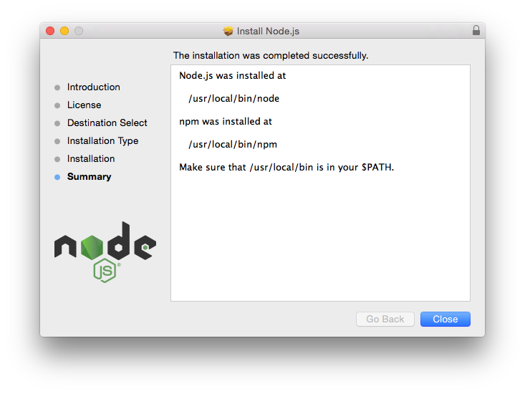
Lab 06 - Getting Started with Node.js

Slide 47
Tooling
Notes:
For the next few labs, we'll use a new folder, outside of the vue-cli project you started, so we can work with and learn about some of the fundamental tools of modern JS development.

Slide 48
Why Have Tooling?
Front-end Web Development is complex.
Modern Web Tooling helps achieve four best practices of software development:
  Version Control
  Automation
  Reproducible Build
  Test-Driven Development

Slide 49
npm
Installs, publishes, and manages node programs
Is bundled and installed with Node
Allows you to install Node.js applications from the npm registry
Written in JavaScript

Slide 50
Other package managers
npm ships with Node.js and is the default
yarn — created by Facebook; Plug'n'Play install mode
pnpm — hard-links a global store, so disk use stays flat
  Strict by default: a package can only import what it declares
bun — a runtime with a very fast built-in installer
All four read package.json; they differ in the lockfile

Slide 51
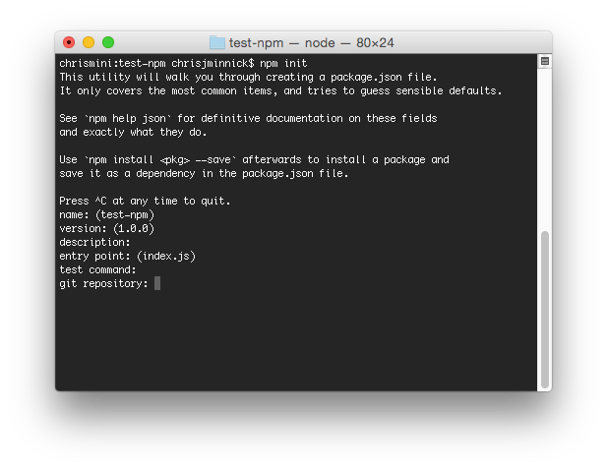
Lab 07 – Initialize npm
Notes:
npm stores information about the packages installed in your project in package.json. Run npm init to create a package.json file.

Slide 52
node_modules
Two ways to install npm packages
  Locally
  Globally
When you install packages locally, they're put into the node_modules directory in your current directory.
You should always run npm install from the same directory as your package.json file, which should be at the root of your project.
Run npm update to update local packages
Run npm outdated to find out which packages are outdated.
Notes:
Important note: This isn't an issue at this point, but if you're working on Windows, you're going to run into a problem sooner or later. Modules that have long chains of dependencies can create long file paths, which can break on Windows. Running npm dedupe usually fixes the problem. Other possible solutions: http://gsferreira.com/archive/2015/07/reduce-the-path-length-of-a-node-js-project/

Slide 53
package.json
Manages locally installed npm packages
Documents packages your project depends on
Specifies the versions of each package your project can use
Makes your build reproducible
Package versions are specified using Semantic versioning (semver)
Semver ranges:
  ~ : patch release - 1.0.x
  ^ : minor release - 1.x
  * : major release - x

Slide 54
npm install
Is used to download and install a package
  (no flag): saves to dependencies — this is the default
  --save-dev (-D): saves to devDependencies
  --save-optional: saves to optionalDependencies
  --save-exact (-E): pins the exact version, no range operator
  --global (-g): installs to a shared location, not the project
npm ci installs strictly from the lockfile — use it in CI

Slide 55
package.json
Every npm package contains this file
Holds metadata relevant to the project
  Identifier Metadata
    Name
    Version
    License
    Description
  Functional Metadata
    Entry point
    Repository
    Scripts
    Dependencies
    Dev Dependencies

Slide 56
Lab 08: Making a Web Server

Slide 57
Demo / Code-along: Set up your own tooling
How to create a Vue.js app with single-file components, starting from an empty directory.
github.com/watzthisco/pro-vue/demos/Vue-Starter
Three dependencies: vue, vite, @vitejs/plugin-vue
Notes:
Follow this process: https://medium.freecodecamp.org/how-to-create-a-vue-js-app-using-single-file-components-without-the-cli-7e73e5b8244f

Slide 58
Static Code Analysis
Objectives
  Learn about lint tools
  Use ESLint
  Configure ESLint with a flat config
  Manual testing with a local dev server

Slide 59
Lint tools
ESLint
  The standard. Pluggable, and "agenda free" - it does not push a particular style
  Flat config (eslint.config.js) since version 9
Biome
  Linter and formatter in one, written in Rust
oxlint
  A very fast linter, also Rust; often run alongside ESLint
Prettier
  A formatter, not a linter - it is about layout, not correctness
JSLint and JSHint came first, and are now rarely used.
Notes:
Linting tools look at your code and look for errors and bad practices.
The first linting tool for JavaScript is JSLint, which was created by Douglas Crockford.
JSLint flags a lot of style issues that Crockford thinks are bad.
JSHint was created in order to give more control over which style issues are checked for.
ESLint is a new tool that is highly customizable and features plugins for many different styles, libraries, and frameworks -- including React and JSX.

Slide 60
Configuring ESLint
Two ways
  Configuration comments
    embed configuration info in JS files with comments
    /* eslint eqeqeq: "off", curly: "error" */
  Configuration files
    eslint.config.js — the "flat config" format
Flat config became the default in ESLint 9
  It exports an array; each entry applies to the files it matches
  .eslintrc.* and .eslintignore were removed in ESLint 10

Slide 61
ESLint: What Can Be Configured?
languageOptions
  ecmaVersion, sourceType, and the parser to use
  globals — the predefined variables the code can rely on
files / ignores
  Which paths this configuration object applies to
plugins
  Imported objects now, not strings resolved by name
rules
  Enable rules at different levels

Slide 62
ESLint Rules
3 Levels
  "off" or 0
    Rule not applied.
  "warn" or 1
    Warn but don't exit.
  "error" or 2
    Error and exit.
Example rules
    {
    "rules": {
    "eqeqeq": "off",
    "curly": "error",
    "quotes": ["error", "double"]
    }
    }

Slide 63
Lab 09 - Automate Linting
Install ESLint into the project
Write an eslint.config.js flat config
Create an npm script called "lint"
Make the lint task a dependency of the default build task

Slide 64
Transpilers
Not all browsers support the same JavaScript and CSS features.
https://caniuse.com
Transpilers convert modern code to a form older browsers accept.
Vite does this for you at build time, guided by browserslist.
  esbuild handles the syntax; the target defaults to browsers with native ES module support.

Slide 65
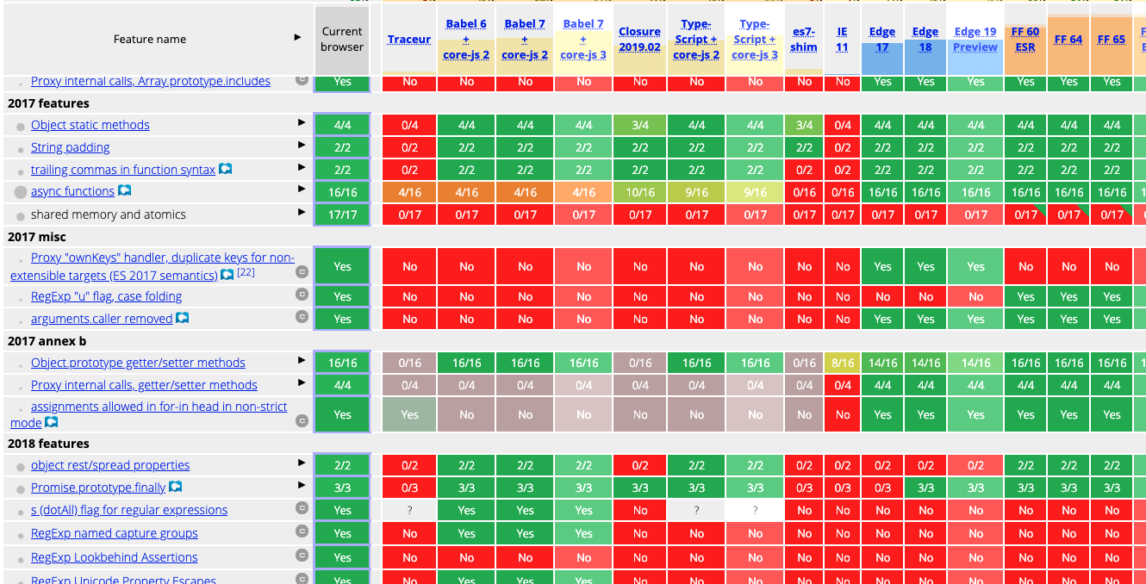
Browser compat-table

Slide 66
Babel and esbuild
Babel is a transpiler.
  Plugin-based, and the reference implementation for new syntax
Vite uses esbuild instead for its dev-time transform
  Written in Go, and roughly two orders of magnitude faster
You rarely configure either one directly in a Vite project

Slide 67
Transpiling Example
ES2015
ES5
let myFunc = ()=>{
let myVar = {
myProp,
};
};
"use strict";
var myFunc = function myFunc() {
var myVar = {
myProp: myProp
};
};

Slide 68
Bundlers
A bundler resolves your import graph and writes deployable files.
webpack — the incumbent; configured with loaders and plugins
Rollup — what Vite uses for production builds
esbuild — what Vite uses to pre-bundle dependencies
In development Vite does not bundle your source at all.

Slide 69
How Vite Works
In development
  Serves your source over HTTP as native ES modules
  Transforms each file only when the browser asks for it
  Pre-bundles dependencies once with esbuild, then caches them
In production
  Bundles with Rollup: tree-shaking, code-splitting, minification
  Each lazily-imported route becomes its own chunk
Plugins extend both pipelines — @vitejs/plugin-vue compiles SFCs

Slide 70
The Document Object Model
Objectives
Understand how the DOM works
Select DOM nodes
Manipulate the DOM with JavaScript

Slide 71
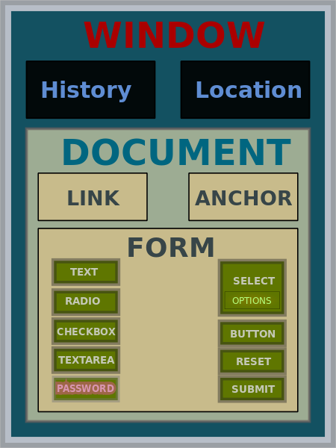
What is the DOM?
JavaScript API for HTML documents
Represents elements as a tree structure
Objects in the tree can be addressed and manipulated using methods.
JohnManuel [GFDL (http://www.gnu.org/copyleft/fdl.html) or
CC BY-SA 3.0 (http://creativecommons.org/licenses/by-sa/3.0)],
via Wikimedia Commons

Slide 72
Understanding Nodes
DOM interfaces that inherit from Node
  Document
  Element
  CharacterData
    Text
    Comment
  DocumentType
Nodes inherit properties from EventTarget

Slide 73
EventTarget
An interface implemented by objects that can receive events (aka event targets)
Examples:
  Element
  Document
  Window
Many event targets support setting event handlers.

Slide 74
DOM Events
Things that happen in the DOM
  abort
  beforeinput
  blur
  click
  compositionend
  compositionupdate
  dblclick
  error
  focus
  focusin
  focusout
  input
  keydown
  keyup
  load
  mousedown
  mouseenter
  mouseleave
  mousemove
  mouseout
  mouseover
  mouseup
  resize
  scroll
  select
  unload
  wheel

Slide 75
Other Events
Many interfaces implement events or inherit events.
Visit http://developer.mozilla.org/en-US/docs/Web/Events.

Slide 76
Element
Interface for elements within a Document
Inherits properties and methods from Node and EventTarget
Most common properties:
  innerHTML
  attributes
  classList
  id
  tagName
Most common methods
  getElementById
  addEventListener
  querySelectorAll

Slide 77
Manipulating HTML with the DOM
You can get and set properties of HTML elements with JavaScript through the DOM
//starting HTML and DOM Element
<p id="favoriteMovie">The Matrix</p>
<script>
getElementById("favoriteMovie")
.innerHTML = "The Godfather";
</script>
//updates DOM, which updates the browser
<p id="favoriteMovie">The Godfather</p>

Slide 78
Manipulating HTML with the DOM
<ol id="favoriteSongs">
<li class="song"></li>
<li class="song"></li>
<li class="song"></li>
</ol>
<script>
var mySongs=document
.querySelectorAll("#favoriteSongs .song");
mySongs[0].innerHTML = "My New Favorite Song";
</script>

Slide 79
Manipulating HTML with JQuery
<ol id="favoriteSongs">
<li class="song"></li>
<li class="song"></li>
<li class="song"></li>
</ol>
<script>
$("#favoriteSongs .song").first()
.html("My New Favorite Song");
</script>

Slide 80
Manipulating HTML with React
<div id="favoriteSongs"></div>
function FavoriteSongs({ song }) {
return (
<ol>
<li className="song">{song}</li>
</ol>
);
}
createRoot(document.getElementById('favoriteSongs'))
.render(<FavoriteSongs song="My New Favorite Song" />);

Slide 81
Manipulating HTML With Vue.js
<div id="favoriteSongs">
<ol>
<li v-for="song in songs" :key="song.title" class="song">
{{ song.title }}
</li>
</ol>
</div>
import { createApp } from 'vue'
createApp({
data() {
return {
songs: [
{ title: 'Walk This Way' },
{ title: 'Give It Away' },
{ title: 'My Way' }
]
}
}
}).mount('#favoriteSongs')

Slide 82
Debugging JavaScript

Slide 83
Browser Development Tools
Using Chrome Developer Tools
Using IE F12 Developer Tools

Slide 84
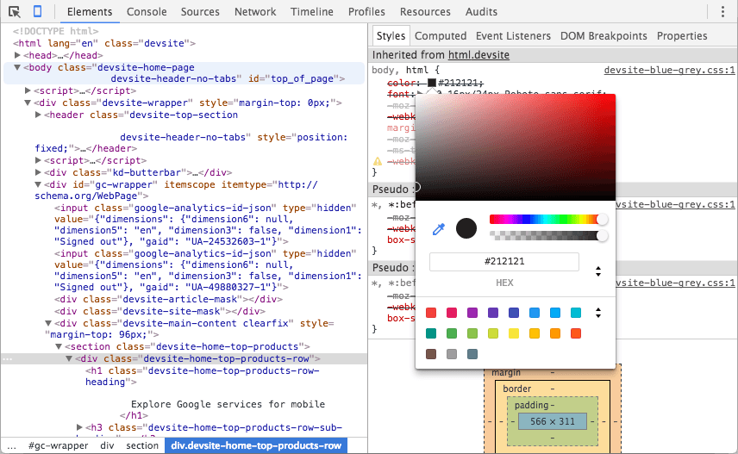
Installing and Using the Vue DevTools

Slide 85
Lab 10: Manual In-Browser Testing and Debugging

Slide 86
Getting Started With Vue.Js

Slide 87
Basic Vue.Js Features

Slide 88
Options API vs. Composition API
Options API
  Code is grouped by option: data, computed, methods, watch
  A single feature is spread across several options
  Reuse means mixins
Composition API
  Code is grouped by feature
  Reuse means composables - ordinary functions
  Better type inference and IDE support
Both are fully supported. This course uses the Composition API, which is what current Vue code is written with.

Slide 89
Creating and Mounting an App
import { createApp } from 'vue'
import App from './App.vue'
const app = createApp(App) // an isolated application instance
app.use(createPinia()) // plugins are installed per app
app.use(router)
app.mount('#app') // where to render
// There is no global Vue object, so two apps on the same page
// never share plugins, components, or configuration.
Notes:
A vue application consists of a root Vue instance created with new Vue. This root instance may be organized into a tree of reusable, nested, components.

Slide 90
<script setup>
<script setup>
import { computed, ref } from 'vue'
import ArticleList from './ArticleList.vue'
const count = ref(0) // state
const doubled = computed(() => count.value * 2)
function increment() { count.value++ } // behavior
</script>
// Every top-level binding is available to the template.
// No export default, no components object, no `this`.

Slide 91
ref and computed
ref(value) wraps any value in a reactive container
  Read and write it as .value in script
  Vue unwraps it for you in the template
computed(getter) derives a cached, read-only value
  Re-evaluates only when something it read has changed
reactive(object) makes an object reactive without .value
  Objects only, and it does not survive destructuring
Reach for ref by default.

Slide 92
Compiler Macros
Available only at the top level of <script setup>. They are not imported - the compiler handles them.
defineProps({ ... }) - declare the props
defineEmits(['change']) - declare the events
defineModel() - a writable v-model ref (3.4+)
defineExpose({ ... }) - expose members to a template ref
defineOptions({ ... }) - set component options such as name
Notes:
n Vue.js, compiler macros are special, globally available functions that can only be used inside <script setup> blocks. They are not actual runtime functions; instead, the Vue compiler detects them during build time and transforms them into standard JavaScript code.
Because they are processed by the compiler, you must not import them. For example, importing defineProps from 'vue' will trigger a linter warning or error.

Slide 93
App-level Configuration
app.component(name, Component) — register globally
app.directive(name, definition) — register a custom directive
app.use(plugin) — install a plugin
app.provide(key, value) — provide a value to every descendant
app.config.errorHandler — catch errors from any component
app.mount(selector) / app.unmount()
Vue 2 set all of these on the global Vue; Vue 3 scopes them to the app instance.

Slide 94
Vue Template Syntax
<script setup>
import { computed, ref } from 'vue'
const message = ref('Hello') // state
const shouted = computed(() => message.value.toUpperCase())
function reset() { message.value = '' } // behaviour
</script>

Slide 95
Vue Templates
Vue compiles templates to Virtual DOM render functions.
Vue Templates are most often written using HTML, but can also be written using JSX or using JavaScript directly.

Slide 96
Using HTML in Templates
Uses mustache syntax for text interpolation
  <div>{{ customerName }}</div>
To output HTML, use the v-html directive
  {{ info }} //outputs as plain text
  <div v-html="info"></div> //output as HTML

Slide 97
Using JavaScript in Templates
Vue supports using JavaScript expressions inside templates and in data bindings.
{{ counter++ }}
{{ loggedIn ? <LogOut /> : <LogIn /> }}
<div v-bind:id="'list-' + id"></div>

Slide 98
Vue.js Directives
Attributes that take a JavaScript expression as their value.
They have a prefix followed by a directive ID
Example:
<div v-if="test">The test is true</div>

Slide 99
Directive Arguments
Directives may take an argument
: is used between directive ID and the argument.
<button v-on:click="doSomething">Click Me</button>

Slide 100
Directive Modifiers
Some directives have modifiers that bind the directive in some particular way.
These modifiers follow a . after the argument.
<form v-on:submit.prevent="doSomething">...</form>
.prevent will call event.preventDefault to prevent the default form action prior to calling the doSomething function.

Slide 101
Vue.js Default Directives
Prefixed with v-
v-bind
  binds attributes to data
v-if
  conditional rendering
v-for
  loops over arrays
v-on
  event handling
v-model
  2-way binding between inputs and app state

Slide 102
Custom Directives
Components are the main way to reuse code.
Still, there may be times when you need low-level DOM access on plain elements.
const vFocus = {
mounted: (el) => el.focus()
}
<input v-focus>
// In <script setup>, a const named vName is usable as v-name.
// The hook names now match the component lifecycle: what Vue 2
// called "inserted" is "mounted".

Slide 103
Loops and Lists
Use the v-for directive to render a list of items from an array or object
<ul>
<li v-for="song in songs" :key="song.id">
{{ song.title }}
</li>
</ul>
const songs = ref([{ id: 1, title: 'Hotel California' }])

Slide 104
Using key
Always provide a key with v-for.
<li v-for="song in songs" :key="song.id">
{{ song.title }}
</li>
Providing a key helps Vue track each node's identity.
The key goes on the element that carries v-for — including on a <template v-for>, which Vue 2 did not allow.
Use a stable id, not the array index.

Slide 105
Using v-for
Renders a list based on an array or object
Often used with HTML lists

Slide 106
v-for with Arrays
<ul id="favorite-songs">
  <li v-for="song in songs">
    {{song.title}}
  </li>
</ul>
...
songs: [
{title: 'Hotel California'},
{title: 'April in Paris'}
]
...
Result:
Hotel California
April in Paris

Slide 107
v-for with Objects
When used with an object, v-for iterates over the properties of the object.
<ul id="object-for-example">
  <li v-for="value in object">
    {{value}}
  </li>
</ul>
...
object: {
firstName: 'Joe',
lastName: 'Smith'
}
...
Result:
Joe
Doe

Slide 108
Conditional Rendering
Use v-if / v-else-if / v-else
<h1 v-if="thing === true">It is so</h1>
<h1 v-else-if="thing === undefined">We don't know</h1>
<h1 v-else>Is it not so</h1>

Slide 109
v-if vs. v-show
v-show can be used for conditional rendering also
The difference is that v-show only toggles the CSS display property.

Slide 110
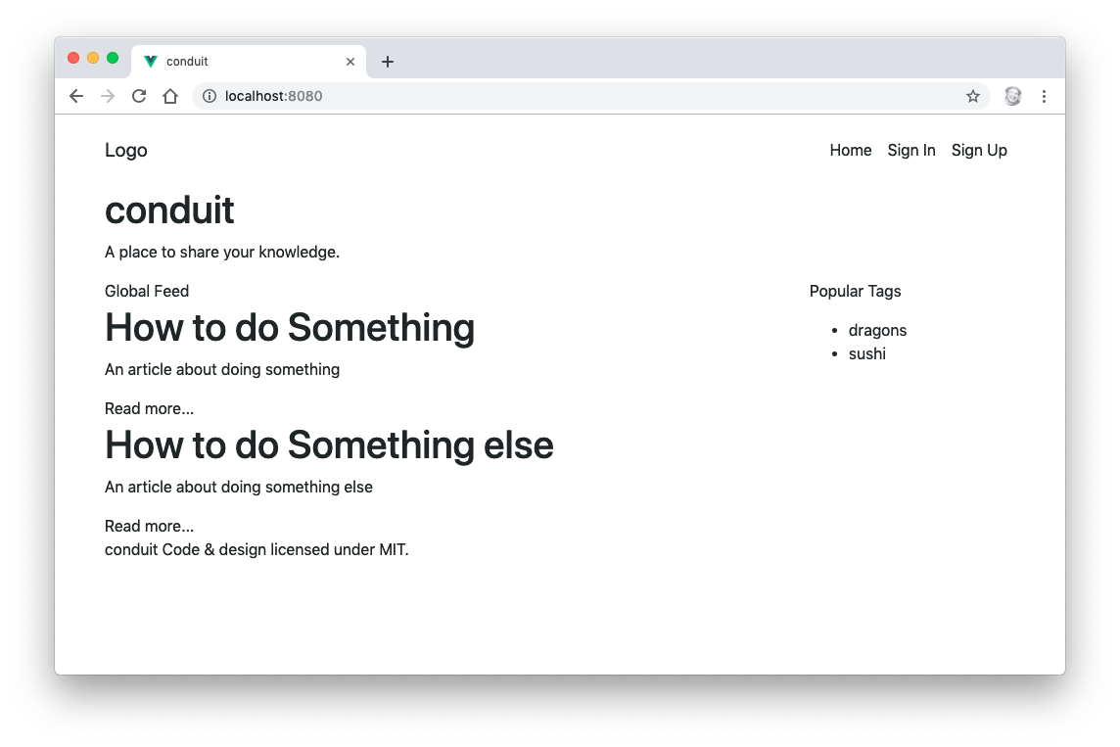
Lab 11: Static Vue View

Slide 111
Binding HTML Classes
:class can be used to dynamically toggle classes
<div :class="{ active: isActive }"></div>
pass an array to :class to apply a list of classes
<div :class="[baseClass, { active: isActive }]"></div>
Vue merges these with any static class attribute on the element.

Slide 112
Adding Styles Conditionally
You can bind a computed property or a ref to the class attribute to change styles based on conditions.
<div :class="[{ active: isActive }, errorClass]"></div>
const errorClass = computed(() => (hasError.value ? 'text-danger' : ''))

Slide 113
Binding Styles
Inline object syntax for :style
<div :style="{ color: activeColor, fontSize: fontSize + 'px' }">
</div>
Bind to a style object to keep the template cleaner
<div :style="styleObject"></div>
const styleObject = reactive({
color: 'red',
fontSize: '13px'
})

Slide 114
Outputting Raw HTML
DEMO

Slide 115
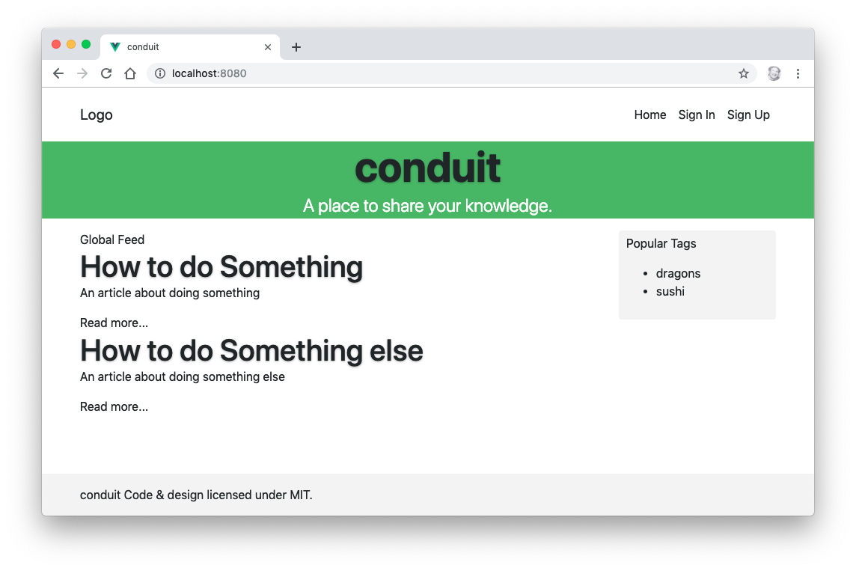
Lab 12: Styling Vue Components

Slide 116
Computed Properties
import { computed, ref } from 'vue'
const firstName = ref('Ada')
const lastName = ref('Lovelace')
const fullName = computed(
() => `${firstName.value} ${lastName.value}`
)

Slide 117
Computed Properties
Useful for operations too complex to sit in a template.
Created by calling computed() with a getter function.
const message = ref('Hi There')
const reversedMessage = computed(() =>
message.value.split('').reverse().join('')
)
// computed() returns a ref, so read it as reversedMessage.value
// in script and as reversedMessage in the template.

Slide 118
Benefits of Computed Properties
Unlike a plain function call, a computed property is cached and will not re-run unless a reactive value it read has changed.
Can often be used instead of a watcher.
A getter should have no side effects — do not mutate state or make requests inside one.

Slide 119
Filtering / Sorting a List with a Computed Property
DEMO

Slide 120
Using Setters in Computed Properties
Computed properties are getter-only by default.
Pass an object with get and set when you need to write to one.
const fullName = computed({
get: () => `${firstName.value} ${lastName.value}`,
set: (newValue) => {
const names = newValue.split(' ')
firstName.value = names[0]
lastName.value = names.at(-1)
}
})

Slide 121
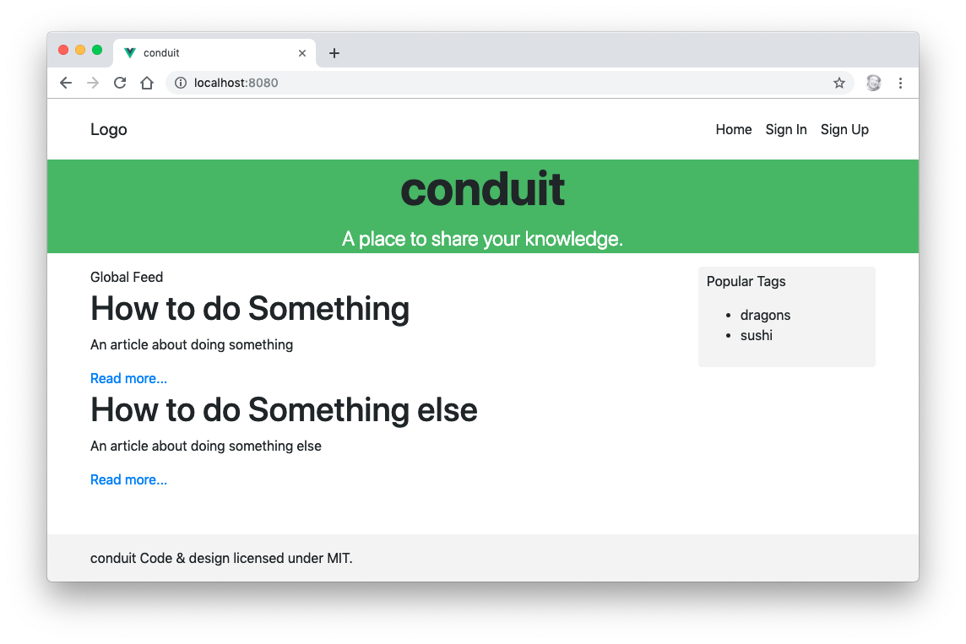
Lab 13: Computed Properties

Slide 122
Reactive State
import { reactive, ref } from 'vue'
const count = ref(0) // any value; use .value
const user = reactive({ name: '' }) // objects only; no .value
// A ref is the default choice. reactive() cannot hold a
// primitive, and loses reactivity if you destructure it.

Slide 123
ref and reactive
State lives in refs, declared at the top of <script setup>.
When a ref changes, every component that read it re-renders.
Vue 3 tracks state with a Proxy, so properties added or deleted after creation are reactive too.
Vue.set and vm.$set existed only to work around that limit in Vue 2, and were removed.

Slide 124
Vue.js Data Binding
Use the v-bind directive (shorthand :) to bind an attribute to a reactive value — one-way binding.
Vue keeps the attribute up to date with the value.
Use the v-model directive to create two-way binding between an input and a ref.

Slide 125
v-bind directive
<!-- bind an attribute -->
<img v-bind:src="imageSrc">
<!-- dynamic attribute name -->
<button v-bind:[key]="value"></button>
<!-- with inline string concatenation -->
<img v-bind:src="'/path/to/images/' + filename">

Slide 126
Value Binding
Use v-bind to bind the value of a radio, checkbox, or select option to a dynamic value.
<input type="checkbox" v-model="toggle" true-value="yes" false-value="no">
<input type="radio" v-model="pick" :value="a">

Slide 127
2-way Binding

Slide 128
v-model directive
Use v-model to create a two-way data binding on form input, textarea, and select elements.
v-model will ignore value, checked or selected attributes

Slide 129
Working with Arrays
All array mutations are reactive, because Vue 3 observes the array through a Proxy:
  push, pop, shift, unshift, splice, sort, reverse
  items[0] = value — assignment by index
  items.length = 0
Vue 2 could not detect the last two, and needed Vue.set and splice as workarounds.
Replacing the array wholesale is still often clearer:
  items.value = items.value.filter(...)

Slide 130
Reactivity Caveats
Proxy-based reactivity is deep and covers add and delete, but a few things still break tracking:
Destructuring a reactive() object copies the values out
  Use toRefs() — or a ref — instead
Replacing a reactive() object wholesale drops the old proxy
Reassigning a ref without .value inside <script setup>
Map, Set, Date and class instances are supported, but a plain object is usually the simpler choice.

Slide 131
Destructuring and Reactivity
const state = reactive({ count: 0 })
const { count } = state // count is now a plain 0
const { count } = toRefs(state) // count is a ref — still live
// The same rule applies to Pinia stores, which is why you
// destructure them through storeToRefs().

Slide 132
v-bind shorthand
<!-- full syntax -->
<a v-bind:href="url"> ... </a>
<!-- shorthand -->
<a :href="url"> ... </a>
<!-- shorthand with dynamic argument (2.6.0+) -->
<a :[key]="url"> ... </a>

Slide 133
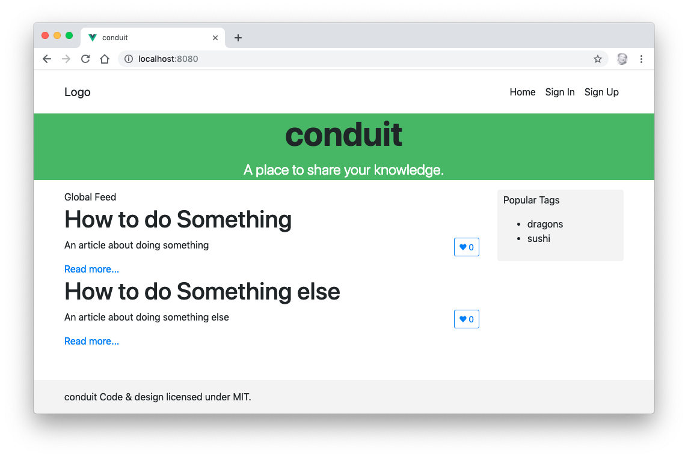
Lab 14: Methods and State

Slide 134
Event Handling
The v-on directive (shorthand @) creates an event listener.
<button @click="counter += 1">Add 1</button>
<p>The button has been clicked {{ counter }} times.</p>
import { ref } from 'vue'
const counter = ref(0)

Slide 135
Inline Event Handling
Use small bits of JavaScript directly in the value of the v-on directive.

Slide 136
Event Handling with Methods
Declare a function in <script setup> and call it from v-on.
const name = ref('Vue.js')
function greet(event) {
alert(`Hello ${name.value}!`)
if (event) alert(event.target.tagName)
}
<button @click="greet">Greet</button>

Slide 137
Event Modifiers
v-on has several modifiers that can be called to handle the details of DOM events.
.stop
.prevent
.capture
.self
.once
.passive
Notes:
.stop = event.stopPropagation() // stop click propagation
.prevent = event.preventDefault() // prevent page reload
.capture // use capture mode (inner element events handled first)
.self // trigger handler if event.target is this element
.once
.passive

Slide 138
v-on shorthand
<!-- full syntax -->
<a v-on:click="doSomething"> ... </a>
<!-- shorthand -->
<a @click="doSomething"> ... </a>
<!-- shorthand with dynamic argument (2.6.0+) -->
<a @[event]="doSomething"> ... </a>

Slide 139
Listening to Child Component Events
Child components declare and emit events
const emit = defineEmits(['enlarge-text'])
<button @click="emit('enlarge-text')">Enlarge text</button>
Parent components listen for them
<BlogPost @enlarge-text="postFontSize += 0.1" />
// An undeclared listener falls through to the root element as a
// native attribute, so always declare your events.

Slide 140
Emitting a Value With an Event
emit can take further arguments
const emit = defineEmits(['enlarge-text'])
<button @click="emit('enlarge-text', 0.1)">Enlarge text</button>
The parent receives them as handler arguments
<BlogPost @enlarge-text="postFontSize += $event" />
<BlogPost @enlarge-text="(n) => postFontSize += n" />
// Vue 2 also offered $on / $off / $once for an "event bus".
// Those were removed in Vue 3 — use a store or provide/inject.

Slide 141
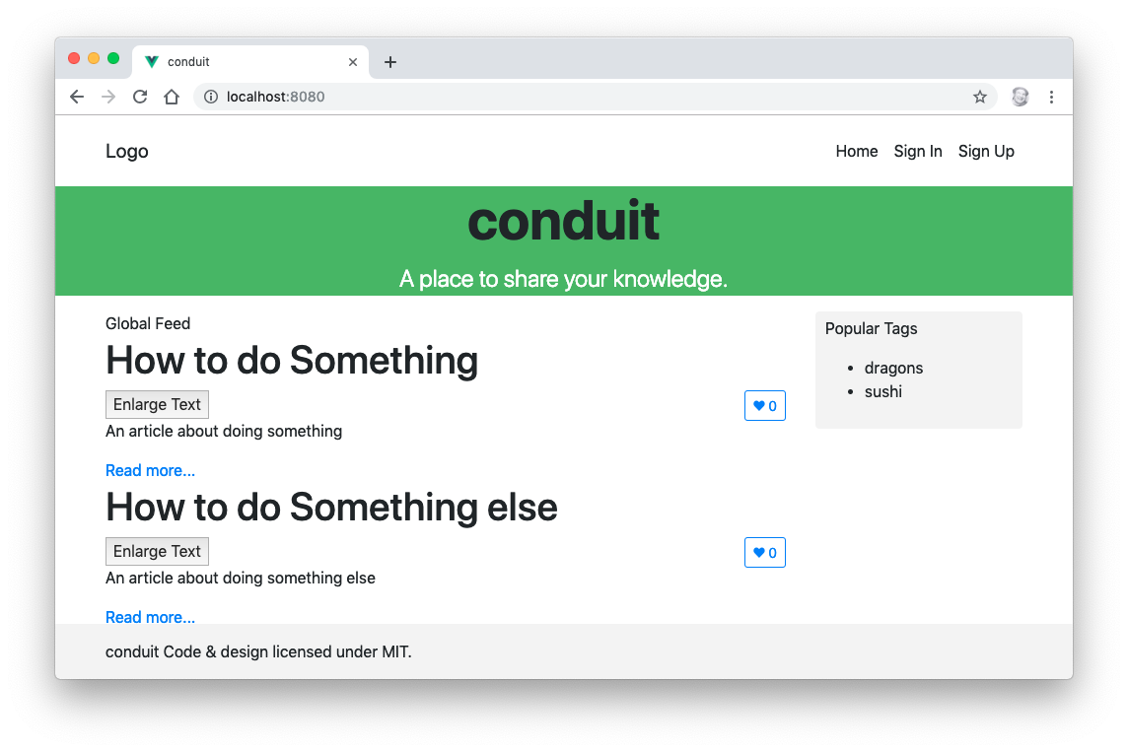
Lab 15: Events

Slide 142
Watchers
A general way to react to state changes.
Most useful for asynchronous or expensive work in response to changing data.
const question = ref('')
const answer = ref('Ask me a question!')
watch(question, async (newQuestion, oldQuestion) => {
answer.value = 'Thinking...'
answer.value = await getAnswer(newQuestion)
})

Slide 143
watch and watchEffect
watch(source, callback)
  Explicit about what it tracks; gives you the old value
  Lazy — the callback does not run until the source changes
watchEffect(callback)
  Tracks whatever the callback reads, automatically
  Runs once immediately
Both return a stop function, and both stop automatically when the component unmounts.
Reach for computed() first — a watcher is for side effects.

Slide 144
Component Lifecycle
Functions imported from vue and called inside <script setup>
  onBeforeMount / onMounted
  onBeforeUpdate / onUpdated
  onBeforeUnmount / onUnmounted
  onErrorCaptured, onActivated, onDeactivated
There is no onCreated — the body of <script setup> is that hook.
Vue 2 named the last pair beforeDestroy and destroyed.

Slide 145
Setup (replacing beforeCreate / created)
The body of <script setup> runs before the component is mounted.
State and props exist; there is no DOM yet.
This is where you declare refs, computed values and functions, and start any request whose result the first render does not need.

Slide 146
onBeforeMount
Runs after the template has been compiled but before the first render.
onBeforeMount(() => {
console.log('about to render')
})
Rarely needed.

Slide 147
onMounted
Full access to the rendered DOM through template refs.
Use for measuring elements and integrating non-Vue libraries.
onMounted(async () => {
articles.value = await fetchArticles()
})
A child is mounted before its parent.

Slide 148
onBeforeUpdate
Runs after state changes, before the DOM is patched.
Use it to read the DOM as it was before the update — for example to record a scroll position.

Slide 149
onUpdated
Runs after state changes and the DOM has re-rendered.
Do not change state here without a guard — you will loop.
To react to one specific value, prefer watch().

Slide 150
onBeforeUnmount
Fires right before teardown, while the component is still fully functional.
Use it to clean up timers, subscriptions and listeners you created yourself.

Slide 151
onUnmounted
Everything attached to the component has been torn down and removed from the DOM.
Watchers and lifecycle hooks are stopped for you; anything you set up by hand is not.

Slide 152
Lifecycle Hooks in Practice
<script setup>
import { onMounted, onUnmounted, ref } from 'vue'
const seconds = ref(0)
let timer
onMounted(() => {
timer = setInterval(() => seconds.value++, 1000)
})
onUnmounted(() => clearInterval(timer))
</script>

Slide 153
Using Lifecycle Hooks
Hooks must be called synchronously in the body of <script setup>
  Not inside a callback, a promise handler, or a condition
That is how Vue knows which component instance to attach them to
They can be called from a composable, because a composable is itself called synchronously from setup

Slide 154
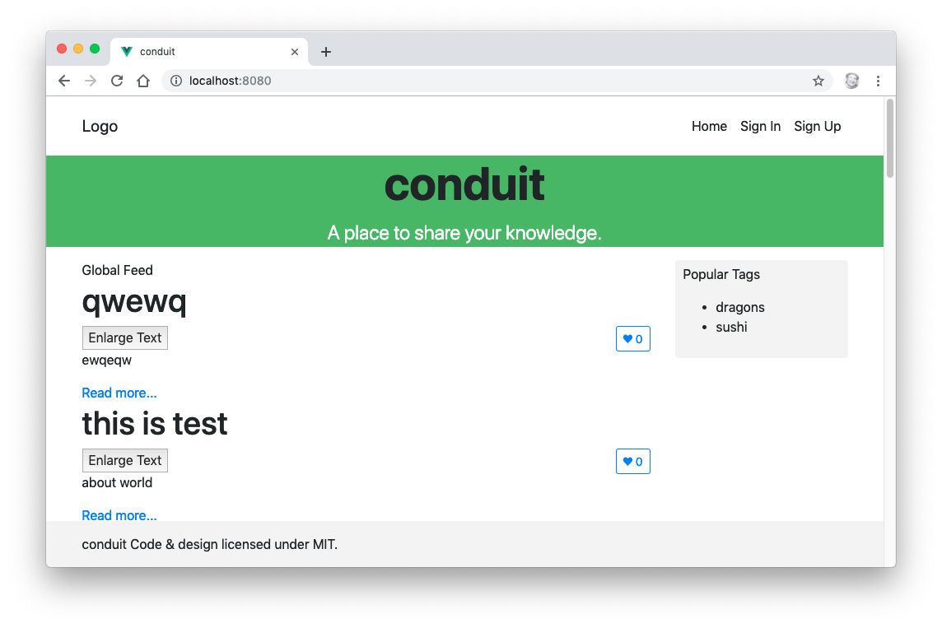
Lab 16: Component Lifecycle

Slide 155
Vue and Forms

Slide 156
Input Bindings
<input v-model="yourAnswer">
<textarea v-model="yourAnswer"></textarea>
<input type="checkbox" id="yourAnswer" v-model="checked">
<input type="radio" id="first" value="First" v-model="picked">
<select v-model="selected">
  <option>A</option>
  <option>B</option>
  <option>C</option>
</select>

Slide 157
2-way Binding Pros and Cons
2-way binding makes development easier
2-way binding makes testing more difficult
v-model is sort of magic (which could be a pro or con)
<input v-model="searchText">
does the same thing as:
<input
:value="searchText"
@input="searchText = $event.target.value" >

Slide 158
Creating a Form with Checkboxes
DEMO

Slide 159
Creating a Form with Radio Buttons
DEMO

Slide 160
Creating a Form with a Select Element
DEMO

Slide 161
Input Modifiers
DEMO

Slide 162
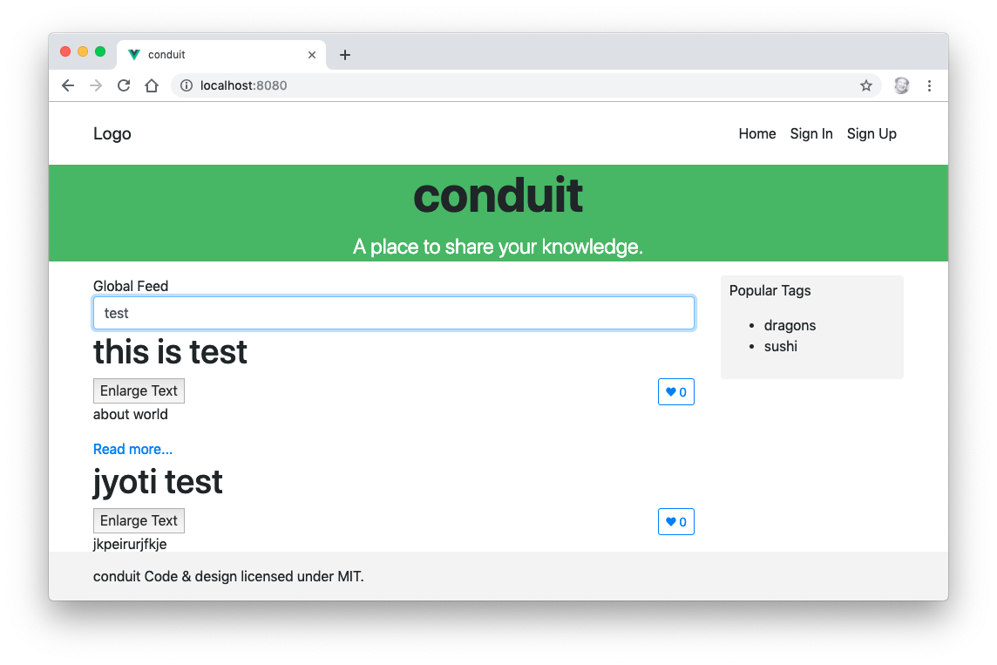
Lab 17: Forms

Slide 163
Vue Components

Slide 164
What are Vue Components?
A reusable piece of UI with its own state, template and styles.
Written as a single-file component: .vue with <script setup>, <template> and <style>.
State is declared with ref() and reactive(), so each instance automatically gets its own copy — this is what the data() function guaranteed in the Options API.
A component may have more than one root element (a Fragment).

Slide 165
Creating a Component
<script setup>
defineProps({
todo: { type: Object, required: true }
})
</script>
<template>
<li>{{ todo.text }}</li>
</template>
// The file name is the component name: TodoItem.vue is used as
// <TodoItem />. Vue 2 wrote Vue.component("todo-item", { ... }).

Slide 166
Organizing and Reusing Components
Apps are usually organized as a tree of nested components.

Slide 167
Naming Components
Two options
  PascalCase — the recommended default
    Matches the file name, and the editor can resolve it
    Distinguishes your components from native HTML elements
  kebab-case
    Required when writing templates directly in the DOM, because HTML tag names are case-insensitive
A component imported in <script setup> can be used under the name you imported it as.

Slide 168
Local Components
The usual case: import the component where you use it.
<script setup>
import PopupWindow from './components/PopupWindow.vue'
</script>
<template>
<PopupWindow />
</template>
// The import is the registration. There is no components option.

Slide 169
Global Components
import { createApp } from 'vue'
import PopupWindow from './components/PopupWindow.vue'
import App from './App.vue'
const app = createApp(App)
app.component('PopupWindow', PopupWindow)
app.mount('#app')
// Registered on the app, not on a global Vue, so a second app
// on the page does not see it.

Slide 170
Global vs. Local
Prefer local registration.
  A reader can see where every component comes from
  Unused components can be tree-shaken out of the bundle
  The editor can jump to the definition
Register globally only for components used on nearly every screen — an icon or a button primitive.

Slide 171
Props
Declare props with the defineProps compiler macro.
const props = defineProps({
todo: { type: Object, required: true },
size: { type: String, default: 'medium' }
})
// In the template write todo directly;
// in script go through props.todo.
// Props are read-only — emit an event to ask for a change.

Slide 172
Passing Data
Pass data from parent to child components using props.
Pass data to props using element attributes.
<todo-item todo = "wash the car" />
A component can have as many props as you need
Any value can be passed to any prop

Slide 173
Using Props
<!-- parent -->
<TodoItem :todo="item" size="large" />
<!-- TodoItem.vue -->
<script setup>
defineProps(['todo', 'size'])
</script>
<template>
<li>{{ todo.text }}</li>
</template>

Slide 174
Fragments: Multiple Root Elements
Vue 2 required a single root element. Vue 3 does not.
<template>
<h1>{{ title }}</h1>
<div v-html="content"></div>
</template>
One caveat: with more than one root, Vue cannot decide where to put inherited attributes, so bind $attrs explicitly if the parent passes class or style.

Slide 175
Using v-model on Components
v-model works on components as it does on inputs
<CustomInput v-model="searchText" />
does the same thing as
<CustomInput
:model-value="searchText"
@update:model-value="searchText = $event" />
// Vue 2 used the value prop and the input event. Vue 3 renamed
// them to modelValue and update:modelValue, which frees up
// value for ordinary use and allows several v-models per
// component: v-model:title, v-model:body.

Slide 176
defineModel
Since Vue 3.4 the whole prop-and-event pair has a shorthand.
<script setup>
const model = defineModel()
</script>
<template>
<input v-model="model">
</template>
// model is a writable ref. Writing to it emits the update event
// for you.

Slide 177
Content Distribution with Slots
Slots allow you to pass the content of an element into a component.
<navigation-link url="/profile">
Your Profile
</navigation-link>
and then access that content inside the component
<a v-bind:href="url">
<slot></slot>
</a>

Slide 178
Cool Things You Do With Slots
Slots can contain any template code, including HTML and components.
Slots can access the same scope as the rest of the template.
Default slot content can be provided.
<slot>default content</slot>
You can create named slots if you need to have multiple slots.

Slide 179
Naming Slots
Parent component:
<base-layout>
<template v-slot:header>
Header content
</template>
<p>Main Content</p>
<template v-slot:footer>
Footer content
</template>
</base-layout>

Slide 180
Using Named Slots
<div class="container">
<header>
<slot name="header"></slot>
</header>
<slot></slot>
<footer>
<slot name="footer"></slot>
</footer>
</div>

Slide 181
using slots
DEMO

Slide 182
More fun with slots
Scoped Slots
Abbreviated Syntax for Default Slots
Destructuring Slot Props
Dynamic Slot Names
Named Slots Shorthand
  v-slot:header can be re-written as #header
<template #header>
<p>template content here</p>
</template>

Slide 183
Lab 18: Slots
Populate the list of tags in the 2nd column dynamically from the feed at /tags (using the same Base URL as the articles feed). Use Slots.
List each article's tags underneath the article. Again, use slots.
Make clicking on the tags in the tag box filter the list of articles.

Slide 184
Loading Components Asynchronously
Wrap a dynamic import with defineAsyncComponent.
import { defineAsyncComponent } from 'vue'
const AsyncModal = defineAsyncComponent(() =>
import('./components/Modal.vue')
)
Vite gives the component its own chunk, downloaded on first use.
Routes get this for free from a lazy route component.
Pair it with <Suspense> to show a fallback while it loads.

Slide 185
Composables

Slide 186
Composable Basics
A composable is a function that uses the Composition API to encapsulate and reuse stateful logic.
By convention it is named use* and lives in src/composables.
It is called synchronously from <script setup>, so it can use lifecycle hooks and watchers on the caller's behalf.

Slide 187
Why Composables Replace Mixins
A mixin merged its options into the component silently:
  You could not tell where an inherited property came from
  Two mixins declaring the same name collided, and the winner was decided by a merge strategy
  A mixin could not take arguments
A composable takes its inputs as parameters and returns its outputs, so both ends are visible at the call site.
Mixins still work in Vue 3, but are documented as legacy.

Slide 188
Writing a Composable
import { computed, ref } from 'vue'
export function useArticleFilter(articles) {
const searchDetails = ref('')
const filterIt = computed(() =>
articles.value.filter((a) =>
a.title.includes(searchDetails.value)
)
)
return { searchDetails, filterIt }
}

Slide 189
Using a Composable
<script setup>
import { ref } from 'vue'
import { useArticleFilter } from '@/composables/useArticleFilter'
const articles = ref([])
const { searchDetails, filterIt } = useArticleFilter(articles)
</script>
// Called twice, you get two independent filters — something a
// mixin could never do.

Slide 190
Composable Conventions
Name it use* so readers know it may register hooks
Call it synchronously from setup, never in a callback
Accept refs or getters as arguments so callers can pass live state; toValue() normalises them
Return plain refs, so the caller can destructure freely
Clean up after yourself in onUnmounted

Slide 191
Community Composables
VueUse — a large collection of ready-made composables
  useLocalStorage, useFetch, useMediaQuery, useDebounce, ...
Worth checking before writing your own
vueuse.org

Slide 192
Lab 19: Composables
Extract the filterIt computed property into a composable and use it from ArticleList.vue.

Slide 193
Using Pinia

Slide 194
Why a Store?

Slide 195
The Problem
Props flow down; events flow up.
That works until two distant components need the same state.
  Passing it through every intermediate component ("prop drilling")
  Two copies that drift out of sync
A store gives that state one owner, outside the component tree.

Slide 196
Pinia
Vue's official state management library.
A store is a composable: you call useSomeStore() to get it.
state, getters and actions — no mutations, no dispatch, no commit.
Type-safe, and each store is its own module by construction.
Replaced Vuex, which is now in maintenance mode.

Slide 197
Pinia vs. Vuex
Vuex Pinia
state state
getters getters
mutations — (actions assign directly)
actions + dispatch('name') actions, called as functions
commit('NAME', payload) this.value = payload
modules one file per store
mapState / mapGetters storeToRefs

Slide 198
Installing Pinia
npm install pinia
import { createPinia } from 'pinia'
const app = createApp(App)
app.use(createPinia())
app.mount('#app')
// Install Pinia before the router, so navigation guards can
// reach the stores.

Slide 199
Defining a Store
import { defineStore } from 'pinia'
export const useCounterStore = defineStore('counter', {
state: () => ({ count: 0 }),
getters: {
double: (state) => state.count * 2
},
actions: {
increment() { this.count++ }
}
})
// 'counter' is the store id, used by the DevTools.

Slide 200
Setup Stores
A store can also be written like <script setup>.
export const useCounterStore = defineStore('counter', () => {
const count = ref(0) // state
const double = computed(() => count.value * 2) // getter
function increment() { count.value++ } // action
return { count, double, increment }
})
// Same store, different syntax. Use whichever reads better;
// setup stores compose more easily, option stores map more
// directly onto a Vuex module you are porting.

Slide 201
State
state is a function that returns a fresh object.
Read and write it directly on the store:
const counter = useCounterStore()
counter.count++
counter.$patch({ count: 10 }) // several changes at once
counter.$reset() // back to the initial state

Slide 202
Getters
Computed properties for a store.
Receive state as their first argument.
Cached, like any computed property.
getters: {
doneTodos: (state) => state.todos.filter((t) => t.done),
doneCount() { return this.doneTodos.length }
}
// Use `this` (and a normal function) to reach other getters.

Slide 203
Using a Store in a Component
<script setup>
import { useCounterStore } from '@/stores/counter'
const counter = useCounterStore()
</script>
<template>
<p>{{ counter.count }} / {{ counter.double }}</p>
<button @click="counter.increment()">+1</button>
</template>

Slide 204
storeToRefs
A store is reactive, so destructuring it copies values out and breaks reactivity.
const { count, double } = counter // WRONG — not reactive
import { storeToRefs } from 'pinia'
const { count, double } = storeToRefs(counter) // refs
const { increment } = counter // actions are
// plain functions
// storeToRefs is the replacement for mapState and mapGetters.

Slide 205
Actions
An action is just a method on the store.
It may be async, and it assigns to state through this.
actions: {
async fetchArticles(params) {
this.isLoading = true
try {
const { data } = await ArticlesService.query(params.type)
this.articles = data.articles
} finally {
this.isLoading = false
}
}
}

Slide 206
No Mutations
Vuex separated synchronous mutations from asynchronous actions so the devtools could record every state change.
Pinia tracks changes through the reactivity system instead, so the separation is unnecessary.
The result: no mutation types, no commit, no string constants — one less indirection between the component and the state.
$subscribe and $onAction are still there if you need to observe changes, for logging or persistence.

Slide 207
Multiple Stores
Every store is a separate module by construction.
src/stores/
auth.js -> useAuthStore
home.js -> useHomeStore
A store can use another store — just call its use-function.
// Vuex needed modules, namespacing, and 'module/action' strings.

Slide 208
Pinia and the DevTools
Vue DevTools shows every registered store
  Inspect and edit state live
  A timeline of actions, with arguments and results
  Time-travel debugging
Stores appear as soon as they are first used.

Slide 209
Persisting Store State
Pinia is extended with plugins.
pinia.use(({ store }) => {
store.$subscribe((_mutation, state) => {
localStorage.setItem(store.$id, JSON.stringify(state))
})
})
// pinia-plugin-persistedstate packages this up.

Slide 210
Testing a Store
A store is a plain function — no component needed.
beforeEach(() => setActivePinia(createPinia()))
it('increments', () => {
const counter = useCounterStore()
counter.increment()
expect(counter.count).toBe(1)
})
// @pinia/testing adds createTestingPinia(), which stubs actions.

Slide 211
Lab 20: Implementing Pinia

Slide 212
Single-Page Applications

Slide 213
Creating an SPA with Vue Router
With Vue Router you map components to routes and tell Vue Router where to render them.
A route component is loaded lazily, so it gets its own bundle.

Slide 214
Vue Router: the Template
<script setup>
import { RouterLink, RouterView } from 'vue-router'
</script>
<template>
<nav>
<RouterLink :to="{ name: 'home' }">Home</RouterLink>
<RouterLink :to="{ name: 'login' }">Sign in</RouterLink>
</nav>
<RouterView />
</template>

Slide 215
Vue Router: the JavaScript
import { createRouter, createWebHistory } from 'vue-router'
export default createRouter({
history: createWebHistory(import.meta.env.BASE_URL),
routes: [
{ name: 'home', path: '/',
component: () => import('@/components/Home.vue') },
{ name: 'login', path: '/login',
component: () => import('@/components/Login.vue') }
]
})
// Vue Router 3 wrote new Router({ mode: "history", routes }).

Slide 216
Lab 21: Routing

Slide 217
Lab 22: AJAX with Pinia

Slide 218
Testing

Slide 219
Test-Driven Development
Objectives
  Learn the TDD steps
  Write assertions
  Create tests with Vitest
  Test components with Vue Test Utils
Notes:
In this section, we'll start talking about test-driven development and automated testing.
The key with Test-Driven Development is to work in very small increments.
1. check that the code does was its supposed to do
2. group tests into suites
3. cross browser test automation

Slide 220
Goal of TDD
Clean code that works.

Slide 221
The TDD Cycle
Red
  write a little test that doesn't work.
Green
  make the test work, as quickly as possible.
  don't worry about doing it right.
Refactor
  eliminate duplication created in making the test work.

Slide 222
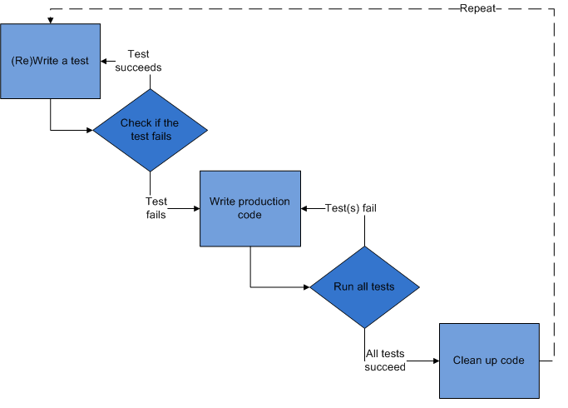
TDD Steps
Write a test
Check that test fails
Write code
Run test - passes!
Refactor
Repeat

Slide 223
Red
Write the story.
Invent the interface you wish you had.
Characteristics of a good tests:
  Each test should be independent of the others.
  Any behavior should be specified in only one test.
  No unnecessary assertions
  Test only one code unit at a time
  Avoid unnecessary preconditions

Slide 224
Green
Get the test to pass as quickly as possible.
Three strategies:
  Fake it
    Do something, no matter how bad, to get the test to pass.
  Use an obvious clean solution.
    But don't try too hard!
  Triangulation
    only generalize code when you have two examples or more.
    When the 2nd example demands a more general solution, then and only then do you generalize.

Slide 225
Refactor
Make it right.
Remove duplication.
Improve the test.
Repeat.
Add ideas or things that aren't immediately needed to a todo list.

Slide 226
Assertions
An expression that encapsulates testable logic
Assertion styles
  expect(buttonText).toBe('Go!'); // Vitest / Jest
  expect(body).to.be.an('array'); // Chai
  assert.deepEqual(obj1, obj2); // node:assert
Vitest's expect is Chai's, with a Jest-compatible surface.

Slide 227
JavaScript Testing Frameworks
Vitest
  Vite-native; shares your Vite config and transforms
Jest
  Long the default; needs its own transform setup for Vite projects
Mocha + Chai
  Runner and assertion library, chosen separately
node:test
  Built into Node.js since 18
Playwright / Cypress
  End-to-end, in a real browser

Slide 228
JS Exception Handling
function hello(name) {
return "Hello, " + name;
}
let result = hello("World");
let expected = "Hello, World!";
try {
if (result !== expected) throw new Error
("Expected " + expected + " but got " +
result);
} catch (err) {
console.log(err);
}
Notes:
By using JavaScript's built-in try throw catch, you can write assertions and throw errors if the test of the assertion doesn't pass. If it doesn't, you can fix the code until the test passes. This test will fail. (node ./src/trythrowcatch.js). You could write an assertion function to simplify this, or you can use an assertion library that already exists.

Slide 229
Vitest Overview
Objectives
  Learn about the different rendering modes
  Learn about Vitest
  Write unit tests with Vitest
Notes:
Jasmine is a Behavior-driven Development framework that includes its own assertion library.

Slide 230
Vitest
The test runner built for Vite
Reuses your vite.config.js — aliases, plugins and .vue handling all work in tests without extra configuration
Runs files named *.spec.js or *.test.js
Simulates a browser environment with jsdom or happy-dom
Jest-compatible API: describe, it, expect, vi.fn()
Watch mode re-runs only the tests affected by your last save

Slide 231
How Vitest Works
Suites describe your tests
Specs contain expectations
import { describe, expect, it } from 'vitest'
describe('A suite is just a function', () => {
it('and so is a spec', () => {
expect(true).toBe(true)
})
})
// Set globals: true in the config to skip the import.

Slide 232
Test Suites
Created using the describe function
Contain one or more specs
2 params
  Text description
  Function
describe('Hello', () => {
// ...
})

Slide 233
Specs
Created using the it or test function
  they're the same thing
Contains one or more expectations
  expectations === assertions
describe('hello', () => {
it('concats Hello and a name', () => {
expect(hello('World')).toBe('Hello, World!')
})
})

Slide 234
Expectations
AKA assertions
Made using expect function,
  Takes a value
Chained to a Matcher
  Takes the expected value
  expect(actual).toEqual(expected);

Slide 235
Matchers
expect(fn).toThrow(e);
expect(value).toBe(other); // Object.is
expect(value).toEqual(other); // deep equality
expect(value).toBeDefined();
expect(value).toBeTruthy() / .toBeFalsy();
expect(number).toBeGreaterThan(n) / .toBeLessThan(n);
expect(value).toBeNull() / .toBeUndefined();
expect(array).toContain(member);
expect(string).toMatch(pattern);
await expect(promise).resolves.toBe(value);

Slide 236
TDD vs. BDD
Test-Driven Development
Behavior-Driven Development
Focused on being useful for programmers
Focused on documentation for non-programmers
  Features, not results
  More verbose
Notes:
The difference between TDD and BDD is subtle and it's mostly in language. TDD is designed for programmers to test software, while BDD helps design and document it. Neither style is better than the other and the choice depends on your framework, what you're comfortable with, and other factors.

Slide 237
TDD Example
describe('Counter', () => {
test('tick increases count to 1', () => {
const counter = new Counter()
counter.tick()
expect(counter.count).toBe(1)
})
})

Slide 238
BDD Example
describe('Counter', () => {
it('should increase count by 1 after calling tick', () => {
const counter = new Counter()
const expected = counter.count + 1
counter.tick()
expect(counter.count).toBe(expected)
})
})

Slide 239
Mocking
vi.fn() — a mock function that records how it was called
vi.mock() — replace a whole module
vi.spyOn() — wrap an existing method, keeping the original
vi.useFakeTimers() — control setTimeout and setInterval
vi.stubGlobal() — replace a global such as fetch

Slide 240
Mock Function
import { expect, it, vi } from 'vitest'
const mockCallback = vi.fn()
[0, 1].forEach(mockCallback)
// The mock function is called twice
expect(mockCallback).toHaveBeenCalledTimes(2)
// It was called with 0, and then with 1
expect(mockCallback).toHaveBeenNthCalledWith(1, 0, 0, [0, 1])

Slide 241
Mocking a Module
Replace a module your component imports, so the test never hits the network.
vi.mock('@/common/api.service', () => ({
default: {
query: vi.fn().mockResolvedValue({ data: { articles: [] } })
}
}))
// vi.mock is hoisted above the imports, so it applies even
// though it is written after them.

Slide 242
Resetting Mocks
Mocks remember every call, so state leaks between tests.
vi.clearAllMocks() // forget recorded calls
vi.resetAllMocks() // also drop the implementation
vi.restoreAllMocks() // undo every spyOn
// Or set restoreMocks: true in the Vitest config.

Slide 243
Fake Timers
vi.useFakeTimers()
const spy = vi.fn()
setTimeout(spy, 5000)
vi.advanceTimersByTime(5000)
expect(spy).toHaveBeenCalled()
vi.useRealTimers()

Slide 244
Snapshot Testing
Renders a component
Writes a snapshot file on the first run
Compares later runs against it, and fails if the output differs
Update deliberately with vitest -u, and review the diff
Best for output that should rarely change; a poor substitute for an assertion about behaviour

Slide 245
Sample Snapshot Test
it('should render content correctly', () => {
const wrapper = mount(Component, {
global: { plugins: [pinia, router] }
})
expect(wrapper.html()).toMatchSnapshot()
})

Slide 246
Vue Test Utils
The official unit-testing utility library for Vue.
Version 2 is the one built for Vue 3.
Changes from version 1:
  propsData is now props
  createLocalVue is gone — use global.plugins
  stubs, mocks and provide moved under global
  setValue and trigger return a promise; await them

Slide 247
mount
Creates a wrapper containing the mounted and rendered component, including all of its children.
const wrapper = mount(Header, {
props: { title: 'Conduit' },
global: { plugins: [router] }
})

Slide 248
shallowMount
Creates a wrapper containing the mounted and rendered component, with its child components stubbed out.
Useful when a child would fetch data or need its own plugins.
const wrapper = shallowMount(Home, {
global: { plugins: [pinia, router] }
})

Slide 249
Lab 23: Testing with Vitest

Slide 250
Testing in a Real Browser

Slide 251
Browser and End-to-End Testing
jsdom is a fast approximation of a browser, not a browser.
Vitest browser mode runs the same tests in a real one, driven by Playwright or WebdriverIO.
Playwright and Cypress drive the whole application end to end.
Karma, which earlier versions of this course covered, was deprecated in 2023.
Notes:
Karma works by starting a server that browsers can connect to. Karma can then serve tests to the browsers to be run in the browser. Another similar test runner is testem.

Slide 252
Transitions and Animations

Slide 253
<Transition>
A built-in wrapper component
Creates enter/leave transitions for the element inside it
Can be used with:
  conditional rendering (v-if)
  conditional display (v-show)
  dynamic components
  a component root node
<TransitionGroup> does the same for a list rendered with v-for

Slide 254
How <Transition> works
When the wrapped element is inserted or removed...
<button @click="show = !show">Toggle</button>
<Transition name="fade">
<p v-if="show">hello</p>
</Transition>

Slide 255
The transition classes
Vue looks for CSS transitions or animations named after the transition's name attribute, and applies these classes in order:
  v-enter-from — the starting state, applied before insertion
  v-enter-active — applied for the whole entering phase
  v-enter-to — the end state of the enter transition
  v-leave-from — the starting state of the leave transition
  v-leave-active — applied for the whole leaving phase
  v-leave-to — the end state, applied until the animation finishes
Vue 2 called the first and fourth v-enter and v-leave. Renaming them is the most common reason an old example stops animating.

Slide 256
Defining the CSS
.fade-enter-active,
.fade-leave-active {
transition: all 0.3s ease;
}
.fade-enter-from,
.fade-leave-to {
transform: translateX(10px);
opacity: 0;
}

Slide 257
JavaScript hooks
<Transition
@before-enter="beforeEnter"
@enter="enter"
@after-enter="afterEnter"
@enter-cancelled="enterCancelled"
@before-leave="beforeLeave"
@leave="leave"
@after-leave="afterLeave"
@leave-cancelled="leaveCancelled"
:css="false"
>
<p v-if="show">hello</p>
</Transition>

Slide 258
Using the JavaScript hooks
Declare the handlers in <script setup>.
function beforeEnter(el) {
el.style.opacity = 0
}
function enter(el, done) {
// call done() when the animation finishes
done()
}
// Set :css="false" so Vue does not also wait for CSS.

Slide 259
Custom Transition Classes
Override the generated class names to plug in a CSS animation library:
  enter-from-class
  enter-active-class
  enter-to-class
  leave-from-class
  leave-active-class
  leave-to-class
Vue 2 named the first and fourth enter-class and leave-class.

Slide 260
Custom Transition Classes Example
<link
href="https://cdn.jsdelivr.net/npm/animate.css@4.1.1"
rel="stylesheet">
<Transition
enter-active-class="animate__animated animate__tada"
leave-active-class="animate__animated animate__bounceOutRight"
>
<p v-if="show">hello</p>
</Transition>

Slide 261
Lab 24: Transitions and Animation
Add a Remove From Feed icon (maybe a trash can) to each article.
When clicked, it should remove the article from the feed.
Animate the transition of the article from showing to hiding

Slide 262
ES2015 (ES6) and Beyond
Objectives
Learn what's new
Use arrow functions and block-scoped variables
Create generator functions
Use classes and modules
Transpile ES6 code to ES5 with Babel

Slide 263
Variable Scoping with const and let
const creates constants
  "immutable variables”
  Cannot be reassigned new content
  The assigned content isn't immutable, however,
    If you assign an object to a constant, the object can still be changed.
let creates block-scoped variables
  Main difference between let and var is that the scope of var is the entire enclosing function.
  Redeclaring a variable with let raises a syntax error
  No hoisting
    Referencing a variable in the block before the declaration results in a ReferenceError.
Notes:
The first new things in ES6 that we'll be talking about are const and let. Unlike variables defined using the var keyword, these new es6 keywords create block-scoped variables. They have some other important differences as well.
Const creats immutable variables -- that is, once you assign a value to a const, the value can't be changed.
Let creates block-scoped variables (variables that are private to their enclosing curly braces, as opposed to having function scope as JavaScript up to this point

Slide 264
let vs. var
var
let
var a = 5;
var b = 10;
if (a===5) {
var a = 4;
var b = 1;
}
console.log(a); // 4
console.log(b); // 1
let a = 5;
let b = 10;
if (a===5) {
let a = 4;
let b = 1;
}
console.log(a); // 5
console.log(b); // 10
Notes:
Here's an example that demonstrates the difference between scoping with let and var.

Slide 265
Block-scoped Functions
ES5
ES6
(function () {
var foo = function () {
return 1;
}
console.log(foo()); // 1
(function () {
var foo = function() {
return 2;
}
console.log(foo()); // 2
})();
console.log(foo()); // 1
})();
{
function foo () { return 1; }
console.log(foo()); // 1
{
function foo () {
return 2;
}
console.log(foo()); // 2
}
console.log(foo()); // 1
}
Notes:
In ES5, we used iffe and function expressions to block-scope function definitions. In ES6, we can create block-scoped function definitions using brackets.

Slide 266
Arrow Functions
aka "fat arrow" functions
A more concise syntax for writing functions
  ES5 (old way)
    function increment(v){
      return v+1;
    }
  Arrow function
    increment = (v) =>{v+1};

Slide 267
Arrow Function Parameters
Surround parameter names with parentheses
  (param1,param2,param3) => { statements }
Parentheses are optional when there's only one parameter name
  singleParam => { statements }

Slide 268
Arrow Functions (cont.)
More intuitive handling of current object context.
  ES6
    this.nums.forEach((v) => {
    if (v % 5 === 0)
    this.fives.push(v);
    });
  ES5
  var self = this;
  this.nums.forEach(function (v) {
  if (v % 5 === 0)
  self.fives.push(v);
  });
Notes:
Arrow functions are always anonymous functions, meaning the only way to assign a name to them is to assign the function to a variable. Arrow functions also handle the this keyword more intuitively, which eliminates the need for the pre-ES6 hack shown here in order to refer to the object that a function is inside.

Slide 269
Default Parameter Handling
ES6
function myFunc (x, y = 0, z = 13) {
return x + y + z;
}
ES5
function f (x, y, z) {
if (y === undefined)
y = 0;
if (z === undefined)
z = 13;
return x + y + z;
};

Slide 270
Rest Parameter
Aggregation of remaining arguments into single parameter of variadic functions.
function myFunc (x, y, ...a) {
return (x + y) * a.length;
}
console.log(myFunc(1, 2, "hello", true, 7));
http://jsbin.com/pisupa/edit?js,console

Slide 271
Spread Operator
Spreading of elements of an iterable collection (like an array or a string) into both literal elements and individual function parameters.
var params = [ "hello", true, 7 ];
var other = [ 1, 2, ...params ];
console.log(other); // [1, 2, "hello", true, 7]
console.log(MyFunc(1, 2, ...params));
var str = "foo";
var chars = [ ...str ]; // [ "f", "o", "o" ]
http://jsbin.com/guxika/edit?js,console

Slide 272
Template Literals
String Interpolation
var customer = { name: "Penny" }
var order = { price: 4, product: "parts", quantity: 6 }
message = `Hi, ${customer.name}. Thank you for your order of ${order.quantity} ${order.product} at ${order.price}.`;
http://jsbin.com/pusako/edit?js,console
Notes:
Template literals are enclosed by the back-tick (` `) (grave accent) character instead of double or single quotes.

Slide 273
Template Literals (cont)
Raw String Access
Allows you to access the raw template string content (without interpreting backslashes)
function tag(strings, ...values) {
console.log(strings.raw[0]);
// "string text line 1 \\n string text line 2"
}
tag`string text line 1 \n string text line 2`;
http://jsbin.com/donibif/edit?js,console
Notes:
You can also access raw strings, without interpretted backslashes.

Slide 274
Enhanced Object Properties
Property Shorthand
  Shorter syntax for properties with the same name and value
ES5
  obj = { x: x, y: y};
ES6
  obj = { x,y };
Notes:
ES6 has a consise syntax for setting properties that have the same name and value. In this case, which part --the name or the value-- do you think the x and y in the ES6 code refers to? It's actually the value. Can you think of a way to check this?

Slide 275
Enhanced Object Properties
Computed names in object property definitions
let obj = {
customer: "Nigel",
[ "order" + getOrderNum() ]: 10
};
http://jsbin.com/wejuqe/edit?js,console

Slide 276
Method notation in object property definitions
ES6
ES5
obj = {
foo (a,b) {
},
bar (x,y) {
}
};
obj = {
foo: function(a, b) {
},
bar: function(x, y) {
}
};

Slide 277
Array Matching
Intuitive and flexible destructuring of Arrays into individual variables during assignment
var list = [ 1, 2, 3 ];
var [ a, , b ] = list; // a = 1 , b = 3
[ b, a ] = [ a, b ];
http://jsbin.com/yafage/edit?js,console

Slide 278
Object Matching
Flexible destructuring of Objects into individual variables during assignment
var { a, b, c} = {a:1, b:2, c:3};
console.log(a); // 1
console.log(b); // 2
console.log(c); // 3
http://jsbin.com/kuvizu/edit?js,console

Slide 279
Symbol Primitive
A unique and immutable data type.
May be used as an identifier for object properties.
Examples:
  var sym1 = Symbol();
  var sym2 = Symbol("foo");
  var sym3 = Symbol("foo"); // Symbol("foo") !== Symbol("foo")
Well-known Symbols
  Built-in symbols, for example Symbol.iterator, which returns the default iterator for an object.
Notes:
each call to Symbol creates a new symbol. In the 2nd and 3rd examples, foo is not coerced into a symbol. "foo" is just an optional description.

Slide 280
User-defined Iterators
Customizable iteration behavior for objects
In order to be iterable, an object must implement the iterator method -- the object, or one of the objects up its prototype chain) must have a property with a Symbol.iterator key.
var myIterable = {}
myIterable[Symbol.iterator] = function* () {
yield 1;
yield 2;
yield 3;
};
[...myIterable] // [1, 2, 3]

Slide 281
For-Of Operator
Convenient way to iterate over all values of an iterable object
let fibonacci = {
[Symbol.iterator]() {
let pre = 0, cur = 1
return {
next() {
[ pre, cur] = [cur, pre + cur]
return { done: false, value: cur }
}
}
}
}
for (let n of fibonacci) {
if (n > 1000)
break;
console.log(n);
}
http://jsbin.com/nururoz/edit?js,console

Slide 282
Creating and Consuming Generator Functions
A generator is a special type of function that works as a factory for iterators.
function* idMaker(){
var index = 0;
while(true)
yield index++;
}
var gen = idMaker();
console.log(gen.next().value); // 0
console.log(gen.next().value); // 1
http://jsbin.com/pozite/edit?js,console

Slide 283
Class Definition
ES6 introduces more OOP-style classes
Can be created with Class declaration or Class expression

Slide 284
Class Declaration
  class Square {
  constructor (height, width) {
  this.height = height;
  this.width = width;
  }
  }

Slide 285
Class Expressions
Can be unnamed
var Square = class {
constructor(height,width) {
this.height = height;
this.width = width;
}
};
Or named
  class Square {
  constructor(height, width) {
  this.height = height;
  this.width = width;
  }
  };

Slide 286
Class Inheritance
class Rectangle extends Shape {
constructor (id, x, y, width, height) {
super (id, x, y);
this.width = width;
this.height = height;
}
}
class Circle extends Shape {
constructor (id, x, y, radius) {
super (id, x, y);
this.radius = radius;
}
}

Slide 287
Beyond ES2015
ES2016
  aka ES7
  New Features
    Exponentiation operator (**)
    Array.prototype.includes
ES2017
  aka ES8
  New Features
    async/await
ES.Next
  Dynamic name for upcoming version

Slide 288
Advanced JavaScript Topics
this, promises, map

Slide 289
"use strict"
Introduced with ES5
Tells browsers to check for common errors and bad practices at run time
Opts in to restricted variant of JavaScript
To invoke:
  put "use strict;" before any other statements
Can also be invoked for functions:
    function myStrictFunction(){
    'use strict';
    …
    }
Is implied in ES6 Modules and Classes
Is redundant in properly written ES6 code.

Slide 290
Understanding this
Allows functions to be reused with different context.
Which object should be focal when invoking a function.

Slide 291
4 Rules of this
Implicit Binding
Explicit Binding
New Binding
Window Binding

Slide 292
What is this?
When was function invoked?
We don't know what this is until the function is invoked.

Slide 293
Implicit Binding
this refers to the object to the left of the dot.
var author = {
name: 'Chris',
homeTown: 'Detroit',
logName: function() {
console.log(this.name);
}
});
author.logName();
Notes:
In this case, this.name is the same as author.name.

Slide 294
Explicit Binding
.call, .apply, .bind
var logName = function() {
console.log(this.name);
}
var author = {
name: 'Chris',
homeTown: 'Detroit"
}
logName.call(author);
Notes:
With explicit binding, you can remove the method from an object and use call to indicate the context. In this case, when logName.call is invoked, this.name refers to author.name.

Slide 295
Explicit Binding with .call
Calls a function with a given this value and the arguments given individually.
var logName = function(lang1) {
console.log(this.fname + this.lname + lang1);
};
var author = {
fname: "Chris",
lname: "Minnick"
};
var language = ["JavaScript","HTML","CSS"];
logName.call(author,language[0]);
Notes:
The first parameter of call is the context. Here, we're saying that the logName function should be run in the context of the author object. After that, you can pass in parameters. We're passing in the first element of an array. The passed parameters are then available, as they normally would be, inside the function, and the properties of the author object are also available, by using the this keyword.

Slide 296
Explicit binding with .apply
Calls a function with a given this value and the arguments given as an array
logName = function(food1,food2,food3) {
console.log(this.fname + this.lname);
console.log(food1, food2,
food3);
};
var author = {
fname: "Chris",
lname: "Minnick"
};
var favoriteFoods= ['Tacos','Soup','Sushi'];
logName.apply(author, favoriteFoods);
Notes:
.apply allows you to bind a function to an object and pass an array to the function, as shown here. We create a function called logName that take 3 parameters. We then create an object called author that has 2 properties and we define an array called favoriteFoods. By using .apply, we run logName in the context of the author object and we pass it the favoriteFoods array, which gets expanded for each of the 3 parameters of the function.

Slide 297
Explicit Binding with .bind
Works the same as .call, but returns new function rather than immediately invoking the function
logName = function(food) {
console.log(this.fname +" " + this.lname +
"\'s Favorite Food was " + food);
};
var person = {
fname: "George",
lname: "Washington"
};
var logMe = logName.bind(person,"Tacos");
logMe();
http://jsbin.com/xikuzog/edit?js,console

Slide 298
new Binding
When a function is invoked with the new keyword, then this keyword inside the object is bound to the new object.
var City = function (lat,long,state,pop) {
this.lat = lat;
this.long = long;
this.state = state;
this.pop = pop;
};
var sacramento = new City(38.58,121.49,"CA",480000);
console.log (sacramento.state);

Slide 299
window Binding
What happens when no object is specified or implied
this defaults to the window object
var logName = function() {
console.log(this.name);
}
var author = {
name: 'Chris',
homeTown: 'Detroit"
}
logName(author); //undefined(error in 'strict' mode)
window.author = "Harry";
logName(author); // "Harry"

Slide 300
Array.map()
Array.map()
  Creates a new array with the results of calling a provided function on every element in this array.
Syntax
  var new_array = arr.map(callback)
Parameters passed to the callback
  currentValue
    The current element being processed
  index
    The index (number) of the current element
  array
    The array map was called upon

Slide 301
Promises

Slide 302
What Are Promises?
An abstraction for asynchronous programming
Alternative to callbacks
A promise represents the result of an async operation
Is in one of three states
  pending – the initial state of a promise
  fulfilled – represents a successful operation
  rejected – represents a failed operation

Slide 303
Promises vs. Event Listeners
Event listeners are useful for things that can happen multiple times to a single object.
A promise can only succeed or fail once.
If a promise has succeeded or failed, you can react to it at any time.
  readJSON(filename).then(success,failure);

Slide 304
Why Use Promises?
Chain them together to transform values or run additional async actions
Cleaner code
  Avoid problems associated with multiple callbacks
    Callback Hell
    Christmas Tree
    Tower of Babel
    Etc

Slide 305
Demo: Callback vs. Promise
Callback
  fs.readFile('text.txt', function(err, file){
  if (err){
  //handle error
  } else {
  console.log(file.toString());
  }
  });
Promise
  readText('text.txt')
  .then(function(data) {
  console.log(data.toString());
  }, console.error
  );

Slide 306
Using Promises
const fs = require('fs');
function readFileAsync (file, encoding) {
return new Promise(function (resolve, reject) {
fs.readFile(file, encoding, function (err, data) {
if (err) return reject(err);
resolve(data);
})
})
}
readFileAsync('myfile.txt')
.then(console.log, console.error);

Slide 307
Async / Await
Simplifies using promises.
async function f() {
return 1;
}
An async function always returns a promise.
f().then(alert);
You can use the await keyword inside an async function to wait until the promise resolves.
async function getUser() {
let response = await fetch('http://someurl.com/user.json');
let user = await response.json();
return user;
}

Slide 308
Disclaimer and Copyright
Disclaimer
WatzThis? takes care to ensure the accuracy and quality of this courseware and related courseware files. We cannot guarantee the accuracy of these materials. The courseware and related files are provided without any warranty whatsoever, including but not limited to implied warranties of merchantability or fitness for a particular purpose. Use of screenshots, product names and icons in the courseware are for editorial purposes only. No such use should be construed to imply sponsorship or endorsement of the courseware, nor any affiliation of such entity with WatzThis?.
Third-Party Information
This courseware contains links to third-party web sites that are not under our control and we are not responsible for the content of any linked sites. If you access a third-party web site mentioned in this courseware, then you do so at your own risk. We provide these links only as a convenience, and the inclusion of the link does not imply that we endorse or accept responsibility for the content on those third-party web sites. Information in this courseware may change without notice and does not represent a commitment on the part of the authors and publishers.
Copyright
Copyright 2026, WatzThis?. All Rights reserved. Screenshots used for illustrative purposes are the property of the software proprietor. This publication, or any part thereof, may not be reproduced or transmitted in any form by any means, electronic or mechanical, including photocopying, recording, storage in an information retrieval system, or otherwise, without express written permission of WatzThis, 567 Commercial St, Astoria, OR 97103. www.watzthis.com
Help us improve our courseware
Please send your comments and suggestions via email to info@watzthis.com

